Slide 1
Presentation on
Deep Learning:
Activation and Loss Functions
By
Dr. Kolla Morarjee
Associate Professor, Department of CSE
Chaitanya Bharathi Institute of Technology, Hyderabad

Slide 2
Output Activation and Loss Functions
Every neural net specifies
  an activation rule for the output unit(s)
  a loss defined in terms of the output activation
First a bit of review…

Slide 3
Cheat Sheet 1
Perceptron
  Activation function
  Weight update
Linear associator (a.k.a. linear regression)
  Activation function
  Weight update
assumes minimizing number of misclassifications
assumes minimizing squared error loss

Slide 4
Cheat Sheet 2
Two layer net (a.k.a. logistic regression)
  activation function
  weight update
Deep(er) net
  activation function same as above
  weight update
assumes minimizing squared error loss
assumes minimizing squared error loss

Slide 5
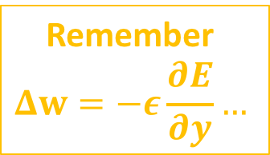
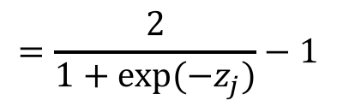


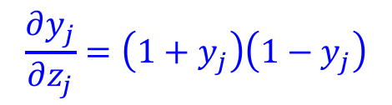

Squared Error Loss
Sensible regardless of output range and output activation function
  with logistic output unit
  with tanh output unit
Remember
$$Δw=−ε\frac{∂E}{∂y}…$$
$$\frac{∂E}{∂y_{j}}=y_{j}−t_{j}$$
$$\frac{∂y_{j}}{∂z_{j}}=y_{j}\left(1−y_{j}\right)$$
$$y_{j}=\tanh\left(z_{j}\right)$$
$$\frac{∂y_{j}}{∂z_{j}}=\left(1+y_{j}\right)\left(1−y_{j}\right)$$
$$=\frac{2}{1+exp⁡(−z_{j})}−1$$

Slide 6
Logistic vs. Tanh
Output = .5
  when no input evidence, bias=0
Will trigger activation in next layer
Need large biases to neutralize
  biases on different scale than other weights
Does not satisfy weight initialization assumption of mean activation = 0
Output = 0
  when no input evidence, bias=0
Won’t trigger activation in next layer
Don’t need large biases
Satisfies weight initialization assumption

Slide 7
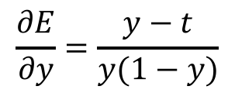
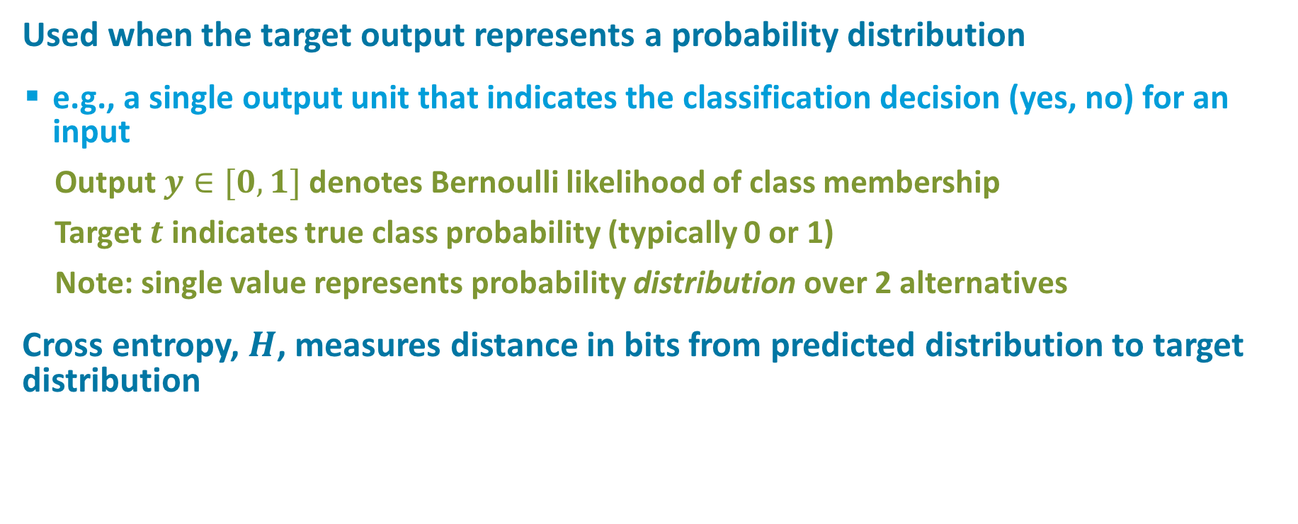

Cross Entropy Loss
Used when the target output represents a probability distribution
  e.g., a single output unit that indicates the classification decision (yes, no) for an input
    Output $y∈[0,1]$ denotes Bernoulli likelihood of class membership
    Target $t$ indicates true class probability (typically 0 or 1)
    Note: single value represents probability distribution over 2 alternatives
Cross entropy, $H$, measures distance in bits from predicted distribution to target distribution
$$\frac{∂E}{∂y}=\frac{y−t}{y(1−y)}$$
$$E=H=−t\text{ln}\left(y\right)−\left(1−t\right)\text{ln}\left(1−y\right)$$

Slide 8
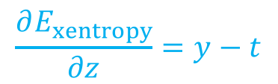
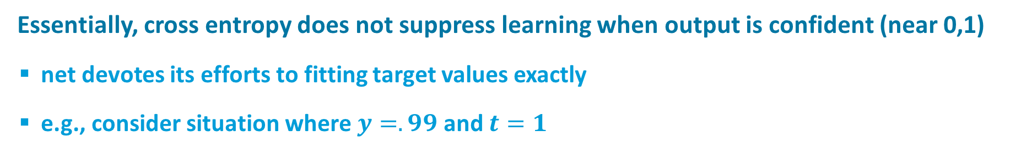
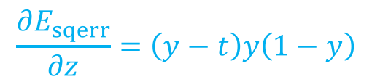
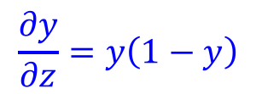
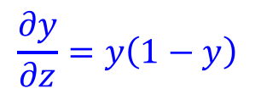
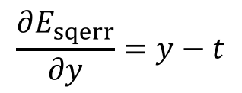
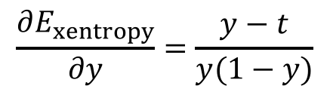
Squared Error Versus Cross Entropy
$$\frac{∂E_{sqerr}}{∂y}=y−t$$
$$\frac{∂E_{xentropy}}{∂y}=\frac{y−t}{y(1−y)}$$
$$\frac{∂y}{∂z}=y\left(1−y\right)$$
$$\frac{∂y}{∂z}=y\left(1−y\right)$$
$$\frac{∂E_{sqerr}}{∂z}=\left(y−t\right)y\left(1−y\right)$$
$$\frac{∂E_{xentropy}}{∂z}=y−t$$
Essentially, cross entropy does not suppress learning when output is confident (near 0,1)
  net devotes its efforts to fitting target values exactly
  e.g., consider situation where $y=.99$ and $t=1$

Slide 9
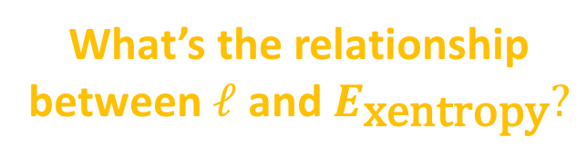
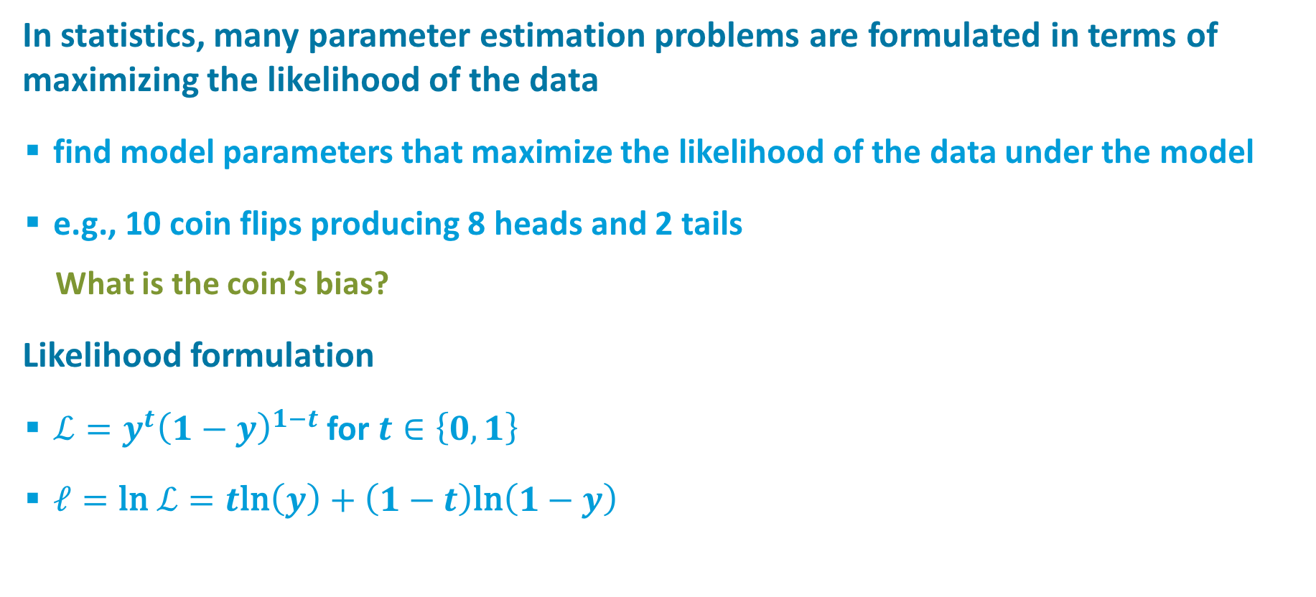
Maximum Likelihood Estimation
In statistics, many parameter estimation problems are formulated in terms of maximizing the likelihood of the data
  find model parameters that maximize the likelihood of the data under the model
  e.g., 10 coin flips producing 8 heads and 2 tails
    What is the coin’s bias?
Likelihood formulation
  $ℒ=y^{t}{\left(1−y\right)}^{1−t}$ for $t∈\left\{0,1\right\}$
  $ℓ=\text{ln} ℒ=t\text{ln}\left(y\right)+\left(1−t\right)\text{ln}\left(1−y\right)$
What’s the relationship between $ℓ$ and $E_{\text{xentropy}}?$

Slide 10
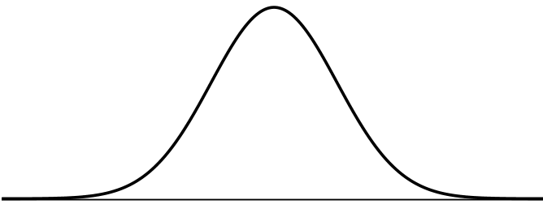
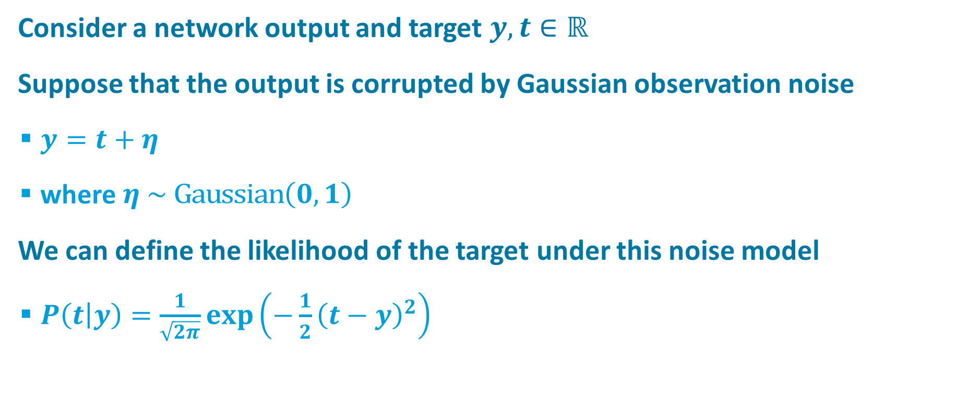

Probabilistic Interpretation of Squared-Error Loss
Consider a network output and target $y, t∈ℝ$
Suppose that the output is corrupted by Gaussian observation noise
  $y=t+η$
  where $η \sim \text{Gaussian}\left(0,1\right)$
We can define the likelihood of the target under this noise model
  $P\left(t | y\right)=\frac{1}{\sqrt{2π}}exp\left(−\frac{1}{2}{\left(t−y\right)}^{2}\right)$
$$y$$

Slide 11
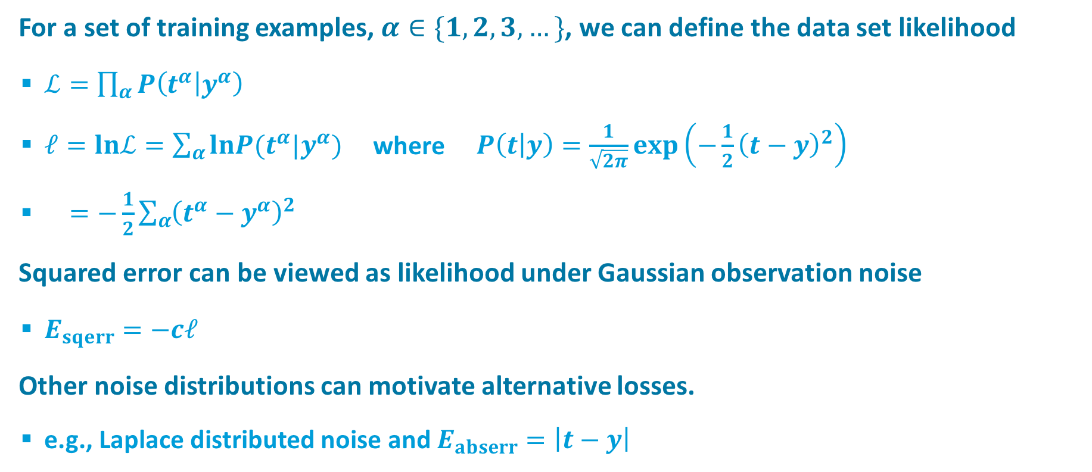

Probabilistic Interpretation of Squared-Error Loss
For a set of training examples, $α∈\{1,2,3, …\}$, we can define the data set likelihood
  $ℒ=\prod_{α}{P\left(t^{α} | y^{α}\right)}$
  $ℓ=lnℒ=\sum_{α}{lnP(t^{α}|y^{α})}$ where $P\left(t | y\right)=\frac{1}{\sqrt{2π}}exp\left(−\frac{1}{2}{\left(t−y\right)}^{2}\right)$
  $=−\frac{1}{2}\sum_{α}{{\left(t^{α}−y^{α}\right)}^{2}}$
Squared error can be viewed as likelihood under Gaussian observation noise
  $E_{sqerr}=−cℓ$
Other noise distributions can motivate alternative losses.
  e.g., Laplace distributed noise and $E_{abserr}=\left|t−y\right|$
What is $\frac{∂E_{abserr}}{∂y}$ ?

Slide 12



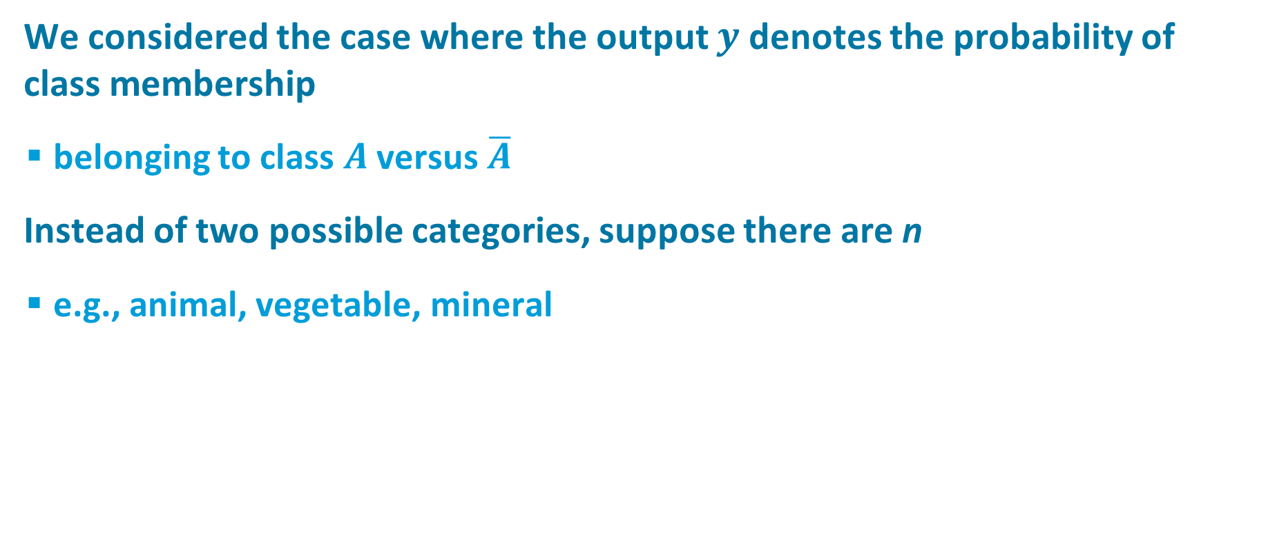
Categorical Outputs
We considered the case where the output $y$ denotes the probability of class membership
  belonging to class $A$ versus $\overline{A}$
Instead of two possible categories, suppose there are n
  e.g., animal, vegetable, mineral

Slide 13
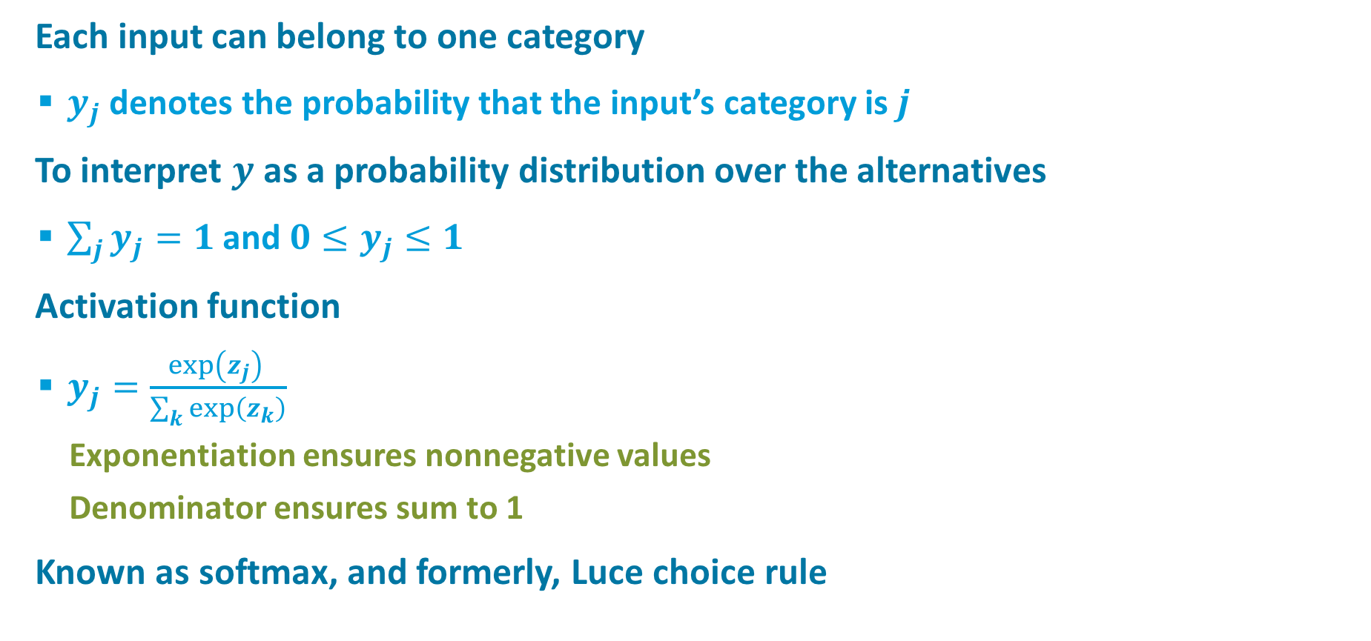
Categorical Outputs
Each input can belong to one category
  $y_{j}$ denotes the probability that the input’s category is $j$
To interpret $y$ as a probability distribution over the alternatives
  $\sum_{j}{y_{j}=1}$ and $0≤y_{j}≤1$
Activation function
  $y_{j}=\frac{exp\left(z_{j}\right) }{\sum_{k}{exp\left(z_{k}\right)}}$
    Exponentiation ensures nonnegative values
    Denominator ensures sum to 1
Known as softmax, and formerly, Luce choice rule
Notes:
ics colloq: “softmax is the biggest advance in neural nets…”

Slide 14

Derivatives For Categorical Outputs
For softmax output function
Weight update is the same as for two-category case!
…when expressed in terms of $y$

Slide 15
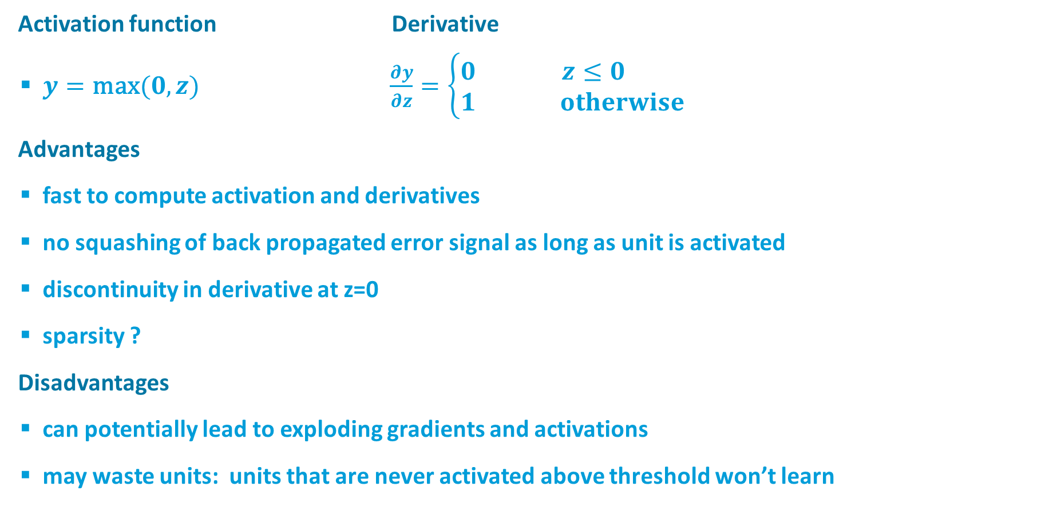


Rectified Linear Unit (ReLU)
$$y$$
$$z$$
Activation function Derivative
  $y=\text{max}(0,z)$ $\frac{∂y}{∂z}=\left\{\begin{matrix}0 & z≤0 \\ 1 & otherwise\end{matrix}\right.$
Advantages
  fast to compute activation and derivatives
  no squashing of back propagated error signal as long as unit is activated
  discontinuity in derivative at z=0
  sparsity ?
Disadvantages
  can potentially lead to exploding gradients and activations
  may waste units: units that are never activated above threshold won’t learn

Slide 16
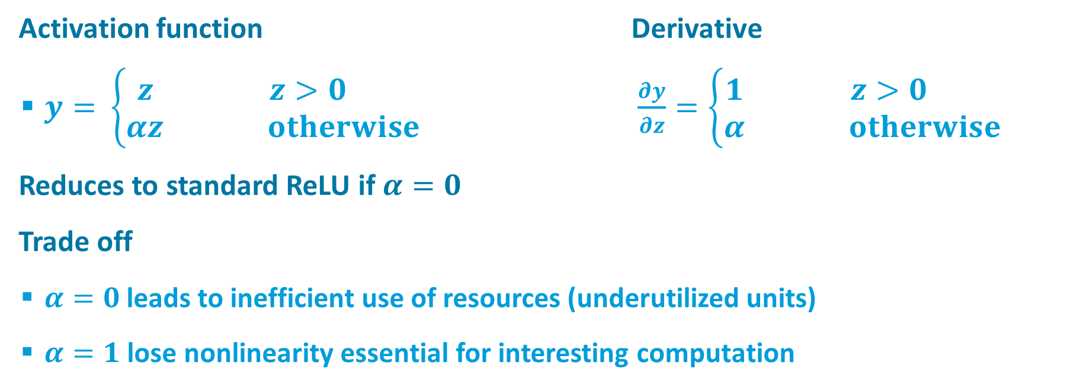
Leaky ReLU
$$y$$
$$z$$
Activation function Derivative
  $y=$ $\left\{\begin{matrix}z & z>0 \\ αz & otherwise\end{matrix}\right.$ $\frac{∂y}{∂z}=\left\{\begin{matrix}1 & z>0 \\ α & otherwise\end{matrix}\right.$
Reduces to standard ReLU if $α=0$
Trade off
  $α=0$leads to inefficient use of resources (underutilized units)
  $α=1$ lose nonlinearity essential for interesting computation

Slide 17
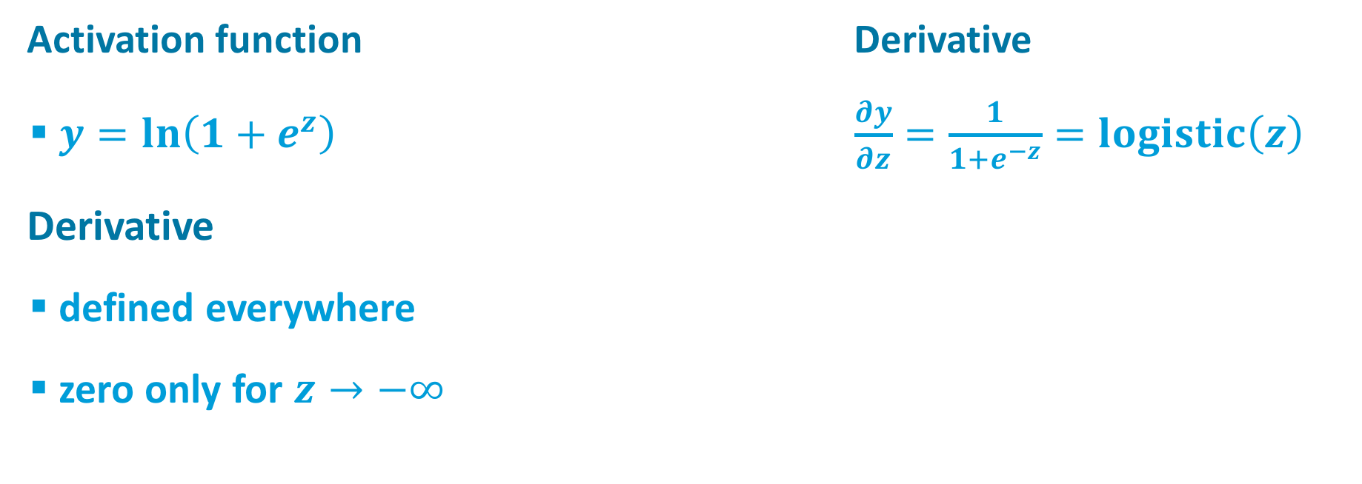
Softplus
$$y$$
$$z$$
Activation function Derivative
  $y=ln\left(1+e^{z}\right) \frac{∂y}{∂z}=\frac{1}{1+e^{−z}}=logistic\left(z\right)$
Derivative
  defined everywhere
  zero only for $z→−∞$

Slide 18
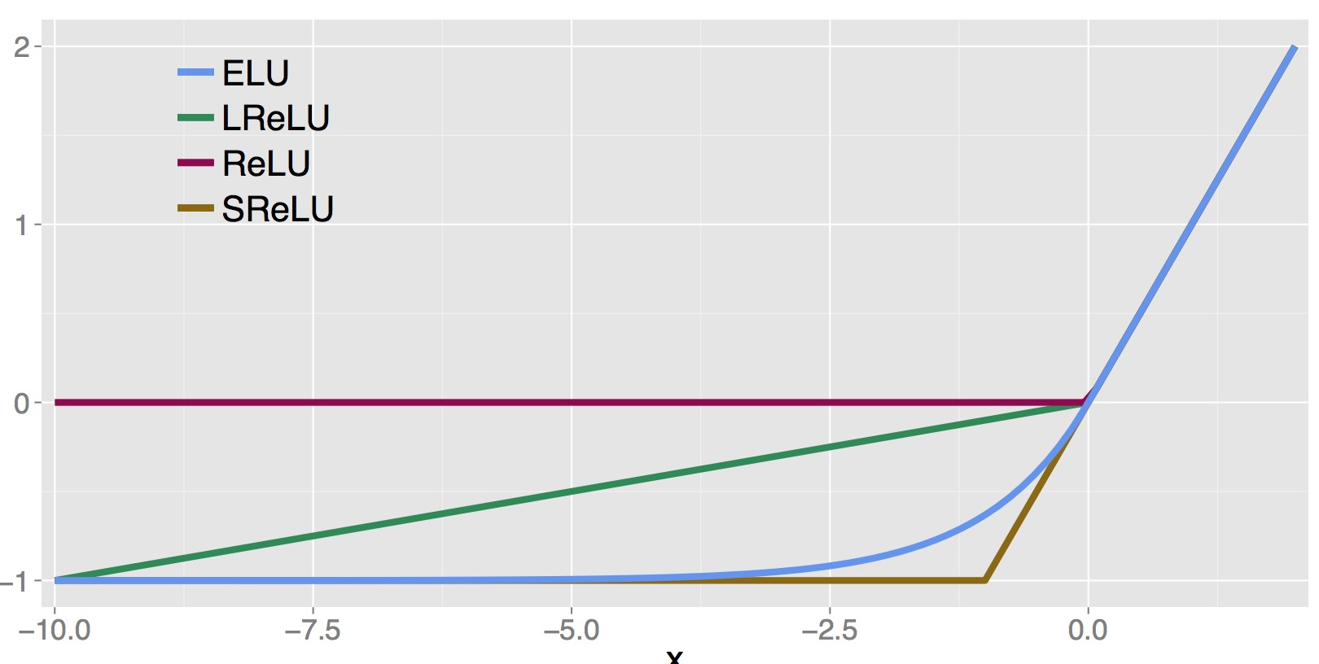

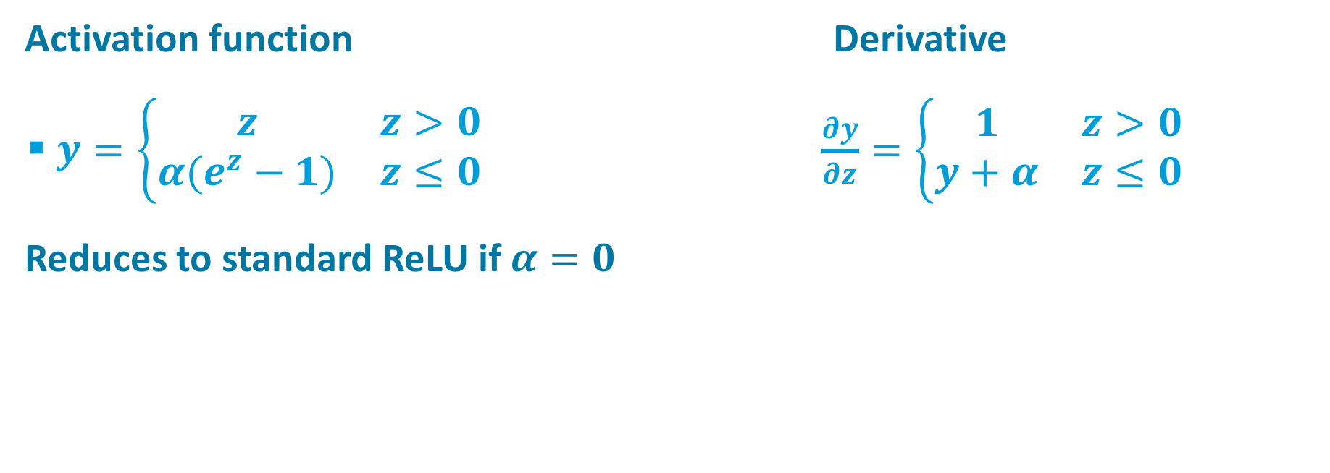

Exponential Linear Unit (ELU)
$$y$$
$$z$$
Activation function Derivative
  $y=\left\{\begin{matrix}z & z>0 \\ α(e^{z}−1) & z≤0\end{matrix}\right. \frac{∂y}{∂z}=\left\{\begin{matrix}1 & z>0 \\ y+α & z≤0\end{matrix}\right.$
Reduces to standard ReLU if $α=0$
$$y$$
$$z$$

Slide 19
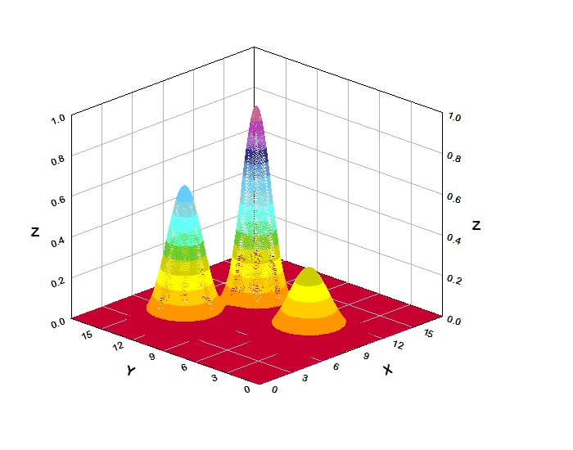
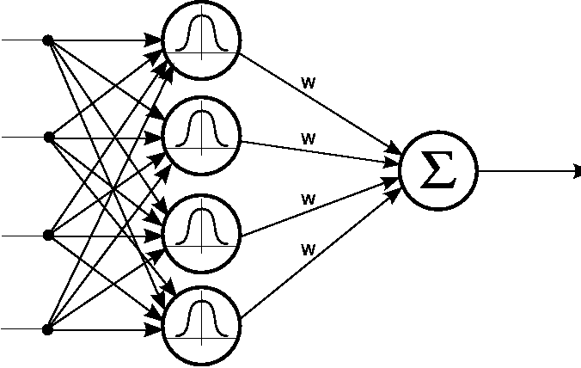



Radial Basis Functions
Image credits: www.dtreg.com
bio.felk.cvut.cz
Activation function
  $y=exp\left(−{\left\|x−w\right\|}^{2}\right)$
Sparse activation
  many units just don’t learn
  same issue as ReLUs
Clever schemes to initialize weights
  e.g., set $w$near cluster of $x$’s
$$x$$
$$w$$

Slide 20

playground.tensorflow.org

