Slide 1
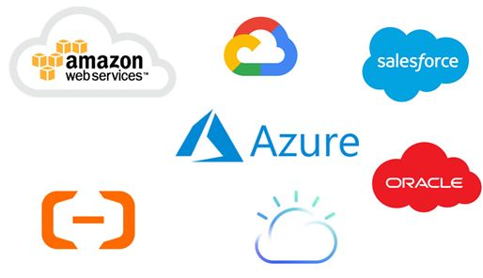
CLOUD COMPUTING

Slide 2
cloud computing?
cloud computing is the delivery of computing services like servers, storages and more over the Internet. The companies that offer these computing services are called cloud providers. They charge for cloud computing services based on usage.
Cloud computing is usually classified on the basis of location, or on the service that the cloud is offering.
Based on a cloud location, we can classify cloud as:
1. Public Cloud
2. Private Cloud
3. Hybrid Cloud

Slide 3
1. Public Cloud – Whole computing infrastructure is located on the premises of a cloud computing company that offers the cloud service.
2. Private Cloud – Hosting all your computing infrastructure yourself and is not shared. The security and control level is highest while using a private network.
3. Hybrid Cloud – using both private and public clouds, depending on their purpose. You host your most important applications on your own servers to keep them more secure and secondary applications elsewhere.

Slide 4
Based on a service that the cloud is offering, we classify as:
1. IaaS (Infrastructure-as-a-Service): IaaS is the most basic category of cloud computing services that allows you rent IT infrastructure (servers or VM’s) from a cloud provider on a pay-as-you-go basis
2. PaaS(Platform-as-a-Service):
Platform-as-a-service (PaaS) refers to the supply an on-demand environment for developing, testing, delivering and managing software applications. It is designed to quickly create web or mobile apps, without worrying about setting up or managing the underlying infrastructure of servers, storage, network and databases needed for development.
3. SaaS(Software-as-a-Service):
Software-as-a-service (SaaS) is a method for delivering software applications over the Internet as per the demand and on a subscription basis. SaaS helps you host and manage the software application and underlying infrastructure and handle any maintenance (software upgrades and security patching).

Slide 5
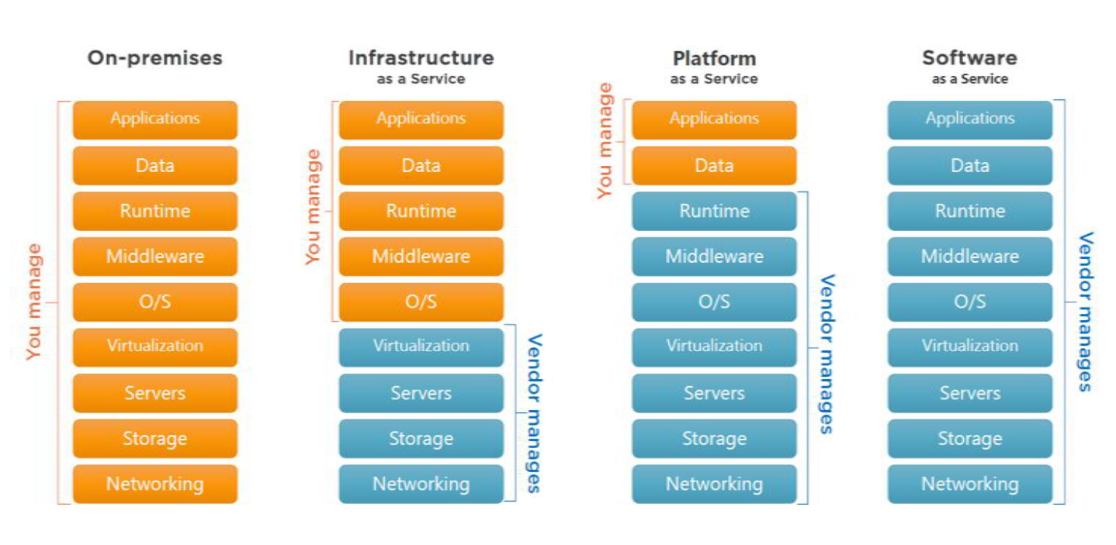

Slide 6
List of top 10 cloud service providers:
1. Microsoft Azure
2. Amazon Web Services (AWS)
3. Google Cloud
4. Alibaba Cloud
5. IBM Cloud
6. VMWare
7. Oracle
8. Salesforce
9. SAP
10.Rackspace Cloud

Slide 7
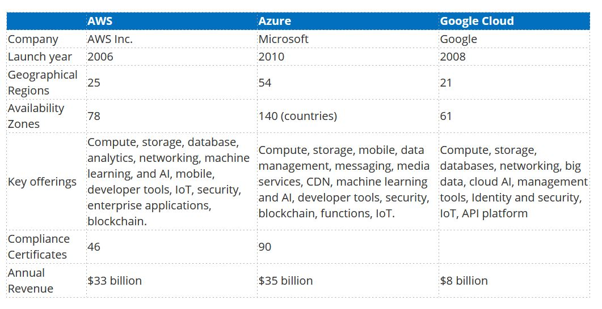
Gartner Survey:

Slide 8
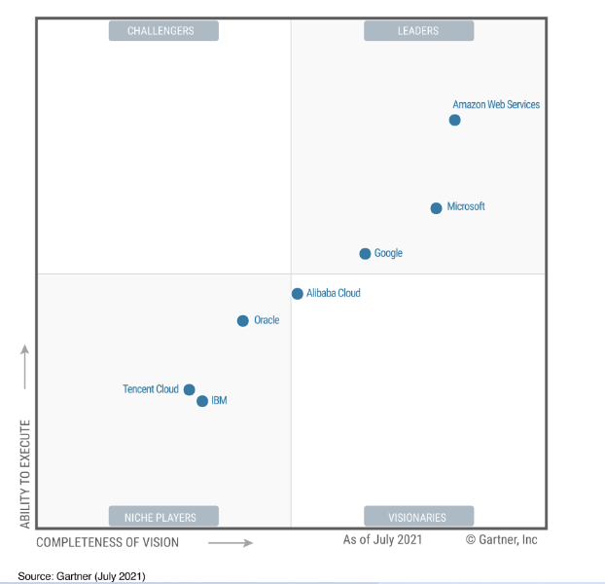

Slide 9
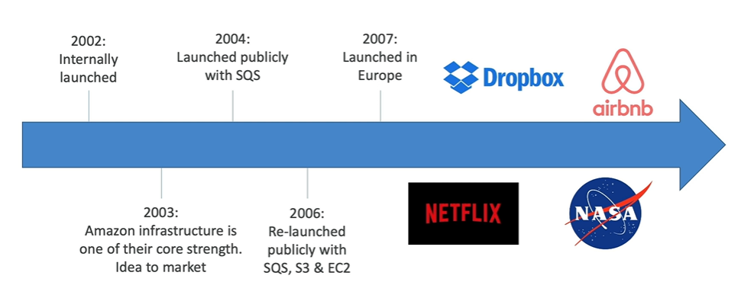

Slide 12
Regions and Availability Zones:
27 Regions
Each Region has multiple availability zones.
Total 84 availability zones

Slide 13
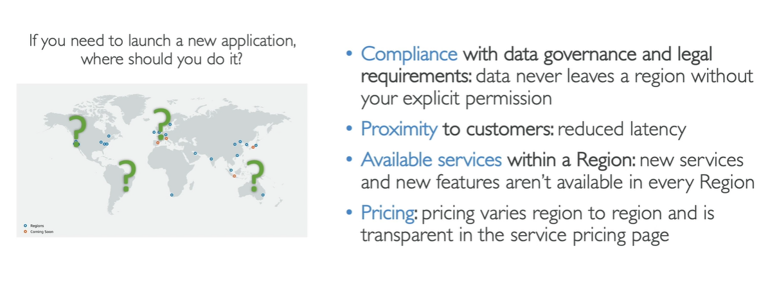
How to choose region?

Slide 14
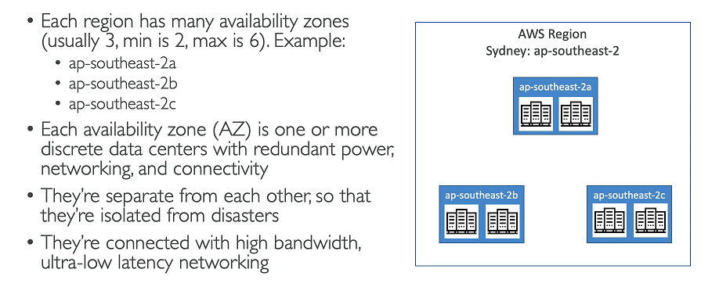

Slide 15
EC2 [Elastic Cloud Compute]
EC2 provides Scalable computing capacity in AWS Cloud. Using EC2 eliminates your need to invest in hardware upfront. So you can develop and deploy applications faster.
We can use EC2 to launch as many as virtual machines as you need, configure security, networking and manage storage.
EC2 purchasing options:
ON-Demand
Reserved
Spot

Slide 16
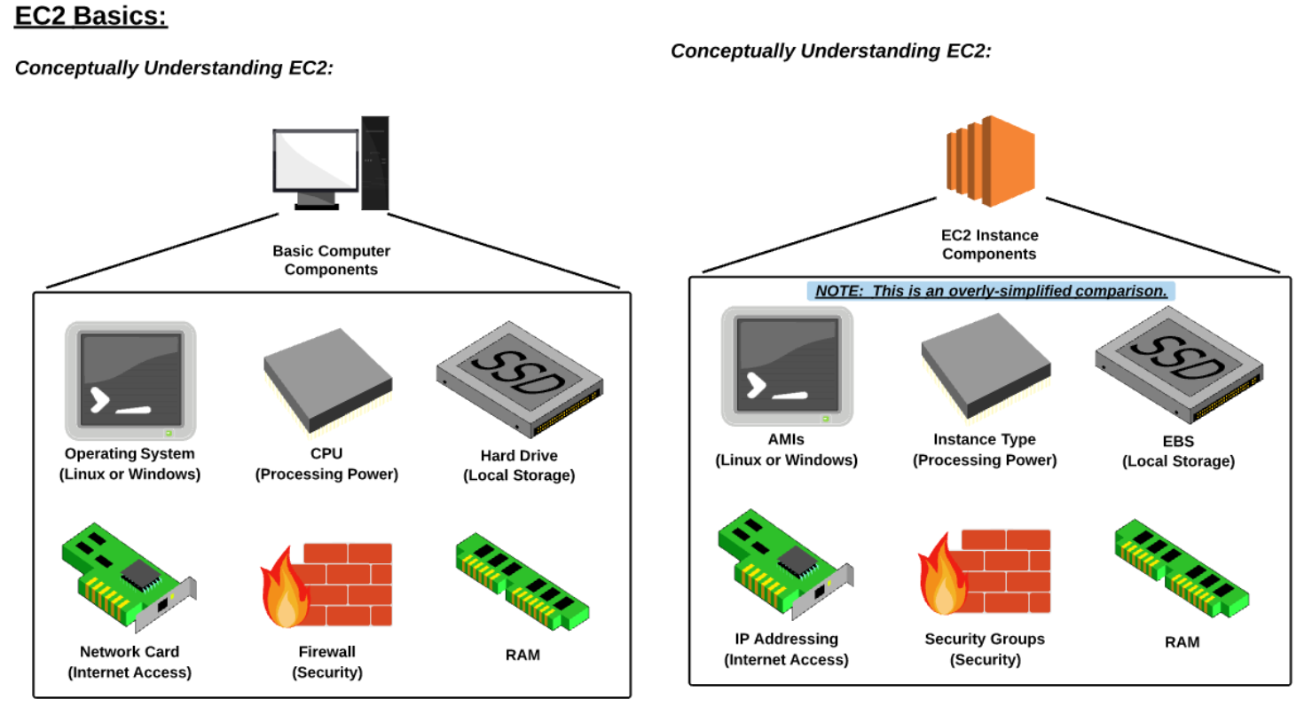

Slide 17
EBS [Elastic Block Storage]
EBS provides persistant Block storage volume for use with Amazon EC2 instances in the AWS cloud.
Each EBS volume is automatically replicated within its Availability zone to protect you from component failure offering high availability & durability.
Often EBS is called as Virtual Hard Disk of Amazon
Different Types of EBS: There are 5 types:
General Purpose
Provisional IOPS
Throughout Optimized
Cold HDD
EBS Magnetic

Slide 19
Elastic IP
An Elastic IP address is a static IPv4 address designed for dynamic cloud computing.
For every EC2 instance, an Elastic IP is not associated.

Slide 20
Port Number
Port number is the part of the addressing information used to identify the senders and receivers of messages in computer networking.

Slide 21
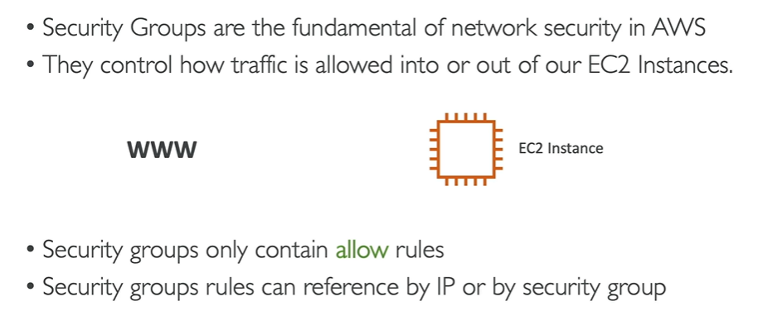
Security Group:
A security Group acts as a virtual firewall that controls the traffic for one or more instances.
When you launch an instance, we associate one or more security groups with the instance. We add rules to each security group that allows traffic to and from its associated instances.

Slide 22
By default all inbound traffic is blocked
By default all outbound traffic is allowed/authorized
Port numbers: Port number is the part of the addressing information used to identify the senders and receivers of messages in computer networking.

Slide 23
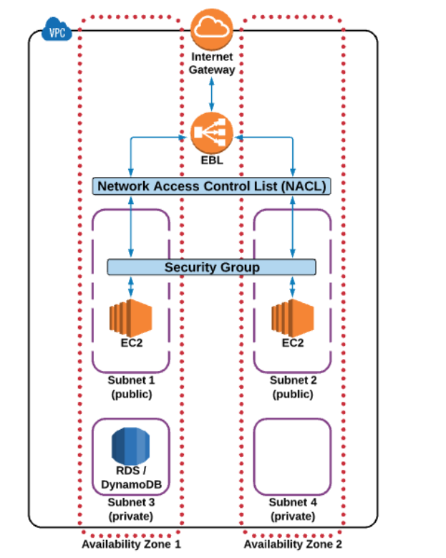
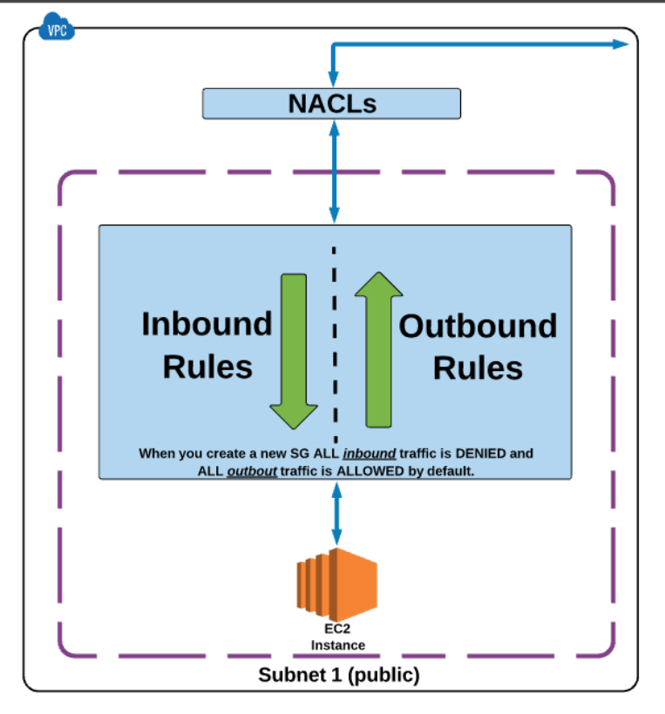

Slide 24
All Inbound traffic is blocked by default.
Changes to security Group will take immediately.
We can have any number of EC2 instances within a security Group.
We can have multiple security Groups attached to a EC2 instance
In security Group, we cannot block specific IP address using security Group instead we can do it in only NACL (Network Access control List)

Slide 25
Volumes:
Amazon EBS volumes are placed in a specific Availability Zone where they are automatically replicated to protect you from the failure of a single component.
All EBS volume types offer durable snapshot capabilities and are designed for 99.999% availability.

Slide 26
Snapshots:
An EBS snapshot is a point-in-time copy of your Amazon EBS volume.
Each AWS snapshot contains all the information needed to restore your data starting from the moment of creating the EBS snapshot.

Slide 27
AMI
An Amazon Machine Image (AMI) provides the information required to launch an instance, which is a virtual server in the cloud.
we can launch as many instances from the AMI.

Slide 28
VPC
Virtual private cloud
Route table
Subnets
Internet Gateway
NAT Gateway

Slide 29
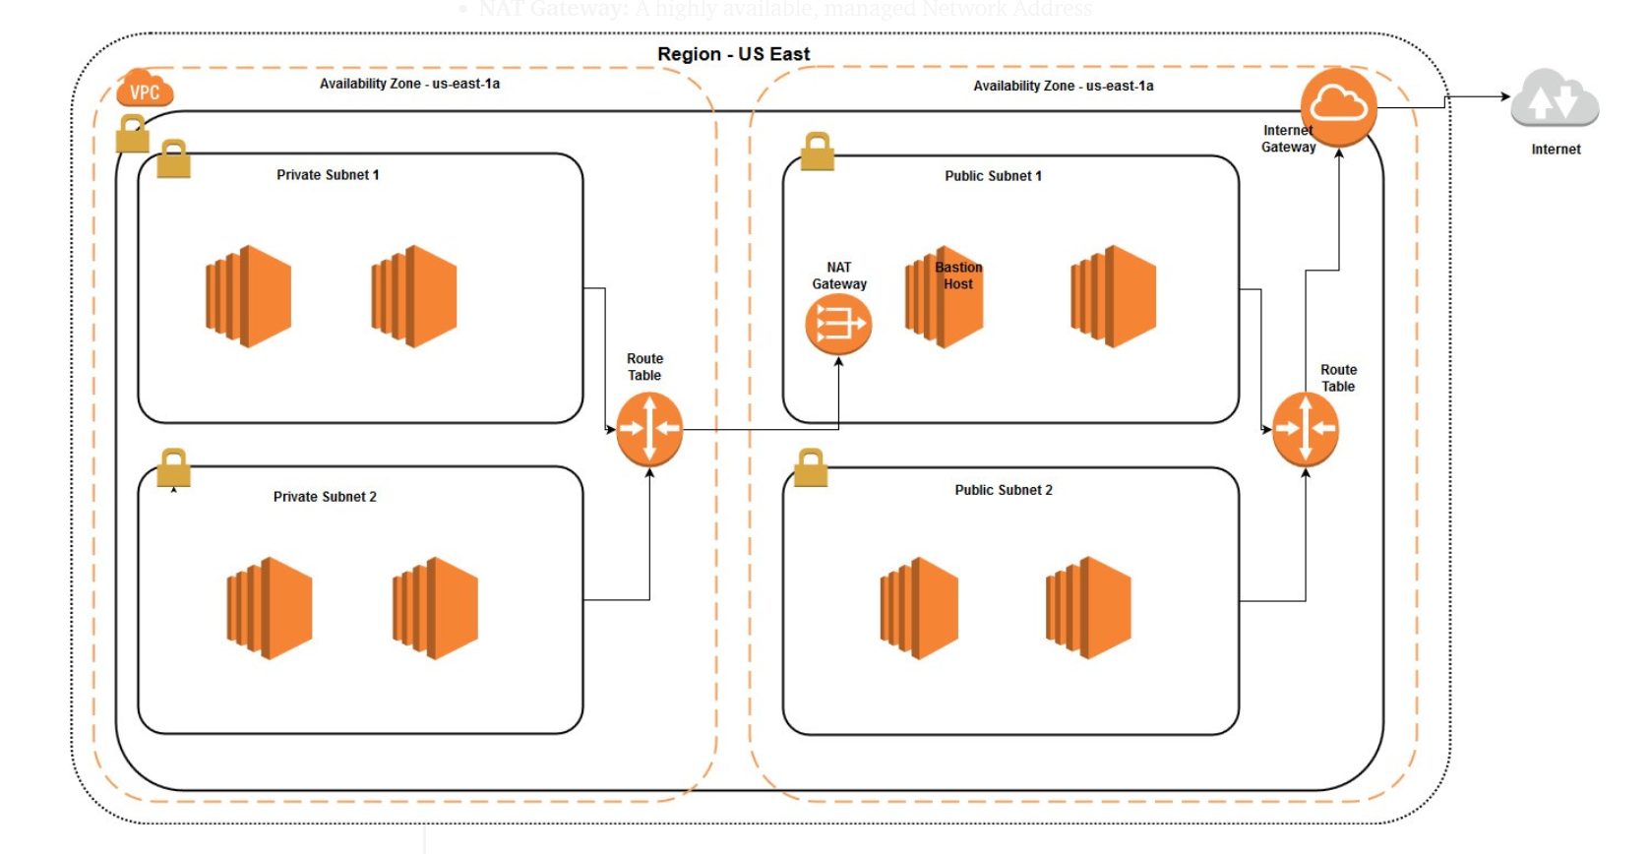
VPC

Slide 30
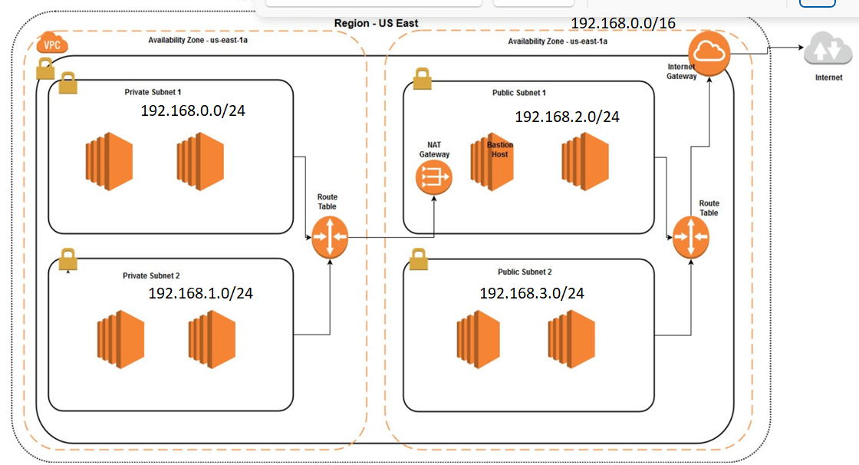
VPC

Slide 31
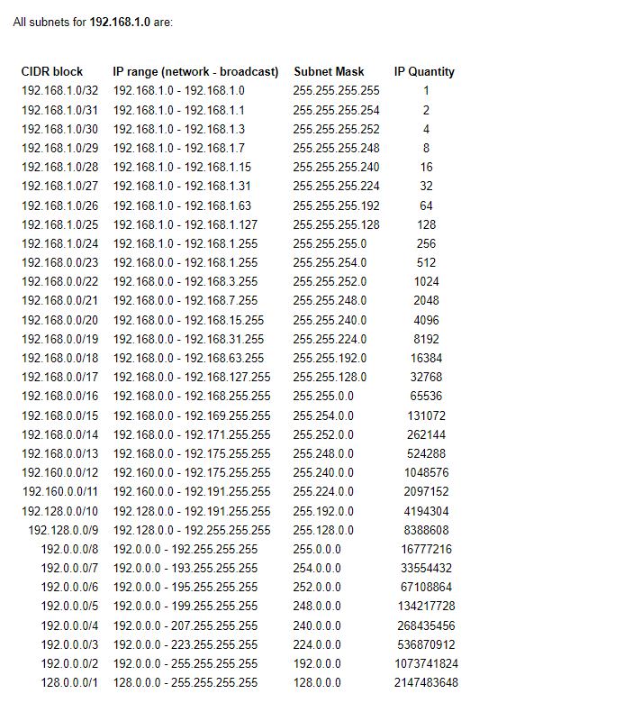
CIDR

Slide 32
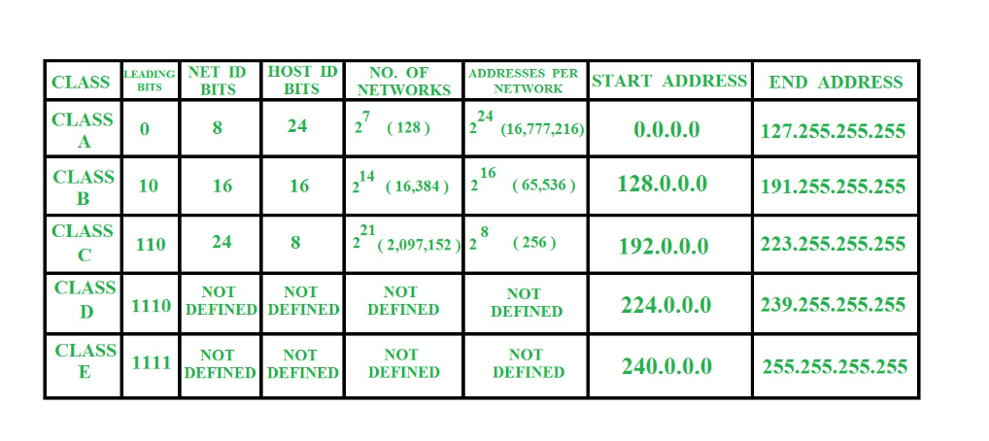
Classful addressing

Slide 33
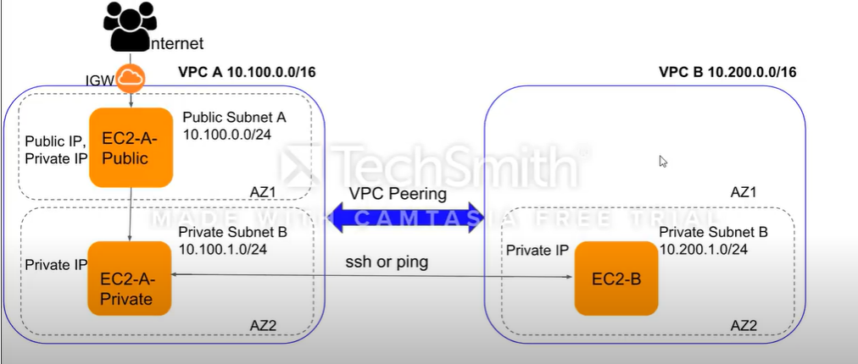
VPC Peering

Slide 34
S3 [Simple Storage Service]

Slide 35
S3 [Simple Storage Service]

Slide 36
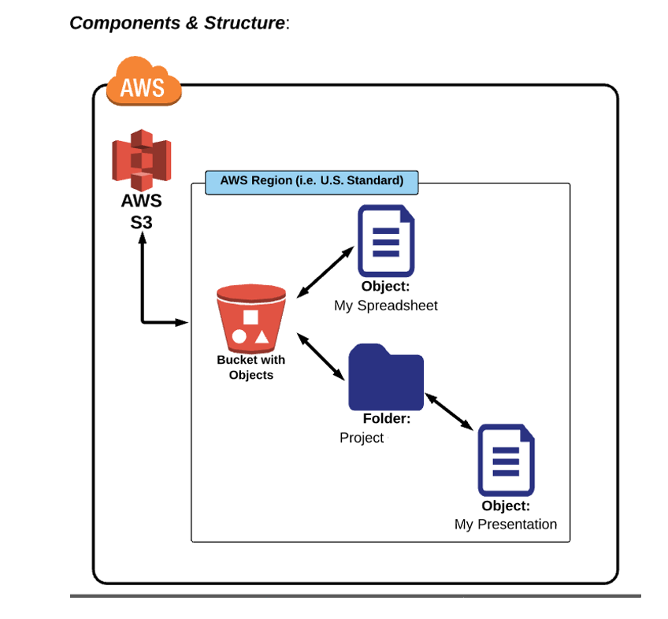
S3 [Simple Storage Service]

Slide 37
THANK YOU

