Slide 1
Agenda
Constructor : __init__() method
Class Variables And Object Variables
The __del__() Method
Public and Private Data Members
Calling a Class Method from Another Class Method
Built-in Functions To Check, Get, Set And Delete Class Attributes
Built-in Class Attributes
Garbage Collection (Destroying Objects)
Inheritance

Slide 2
The __init__() Method (The Class Constructor)
The __init__() method has a special significance in Python classes.
The __init__() method is automatically executed when an object of a class is created.
The method is useful to initialize the variables of the class object.
Note the __init__() is prefixed as well as suffixed by double underscores.
class Box:
def __init__(self,l,b,d): # constructor
self.l=l
self.b=b
self.d=d
def volume(self):
return(self.l*self.b*self.d)
b1 = Box(10,20,30) # during execution of this statement __init__() method will be automatically invoked
vol = b1.volume()
print("Volume",vol)

Slide 3
Create a class called Rectangle, define constructor, area() method and perimeter() method. Use them in main
class Rect:
def __init__(self,l,b):
self.l = l
self.b = b
def area(self):
return(self.l*self.b)
def peri(self):
return(2*(self.l+self.b))
r1 = Rect(3,5)
print(r1.area())
print(r1.peri())

Slide 4
Class Variables And Object Variables
Basically, these variables are of two types- class variables and object variables.
Class variables are owned by the class and object variables are owned by each object.
• If a class has n objects, then there will be n separate copies of the object variable as each object will have its own object variable.
• The object variable is not shared between objects.
• A change made to the object variable by one object will not be reflected in other objects.
If a class has one class variable, then there will be one copy only for that variable. All the objects of that class will share the class variable.
• Since there exists a single copy of the class variable, any change made to the class variable by an object will be reflected to all other objects.

Slide 5
Class Variables And Object Variables - Example

Slide 6
The __del__() Method
The __del__() method does just the opposite work.
The __del__() method is automatically called when an object is going out of scope.
You can also explicitly do the same using the del keyword.
Example:

Slide 7
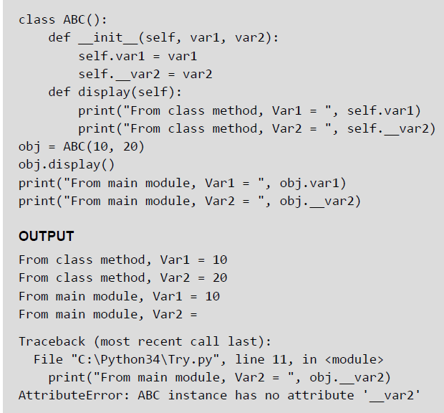
Public and Private Data Members
Public variables are those variables that are defined in the class and can be accessed from anywhere in the program, of course using the dot operator.
Private variables, on the other hand, are those variables that are defined in the class with a double score prefix (__).
These variables can be accessed only from within the class and from nowhere outside the class.

Slide 8
Private Methods
Like private attributes, you can even have private methods in your class.
Usually, we keep those methods as private which have implementation details.
However, if it is very necessary to access them from outside the class, then they are accessed with a small difference.
A private method can be accessed using the object name as well as the class name from outside the class.
The syntax for accessing the private method in such a casewouldbe. objectname._classname__privatemethodname

Slide 9
Calling a Class Method from Another Class Method
Example:

Slide 10
Built-in Functions To Check, Get, Set And Delete Class Attributes
hasattr(obj,name): The function is used to check if an object possess the attribute or not.
getattr(obj, name[, default]): The function is used to access or get the attribute of object.
setattr(obj,name,value): The function is used to set an attribute of the object.
If attribute does not exist, then it would be created.
The first parameter of the setattr() function is the object, the second parameter is the name of the attribute and the third is the new value for the specified attribute.
delattr(obj, name): The function deletes an attribute. Once deleted, the variable is no longer a class or object attribute.

Slide 11
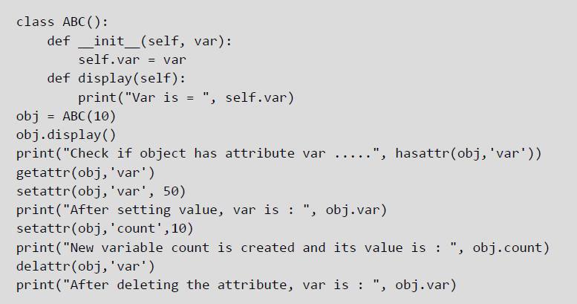

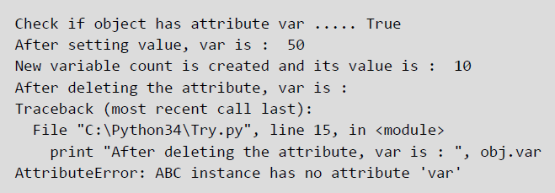
Built-in Functions - Example
© Oxford University Press 2017. All rights reserved.

Slide 12
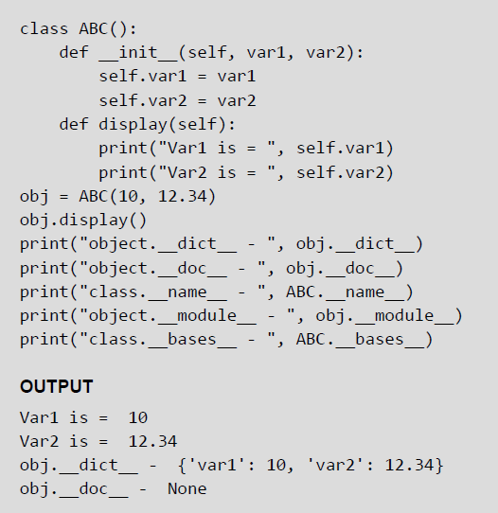
Built-in Class Attributes
.__dict__: The attributes gives a dictionary containing the class's or object's (with whichever it is accessed) namespace.
.__doc__: The attribute gives the class documentation string if specified. In case the documentation string is not specified, then the attribute returns None.
.__name__: The attribute returns the name of the class.
.__module__: The attribute gives the name of the module in which the class (or the object) is defined.
.__bases__: Used in inheritance to return the base classes in the order of their occurrence in the base class list.
Example:
© Oxford University Press 2017. All rights reserved.

Slide 13
Garbage Collection (Destroying Objects)
Python performs automatic garbage collection. This means that it deletes all the objects (built-in types or user defined like class objects) automatically that are no longer needed and that have gone out of scope to free the memory space. The process by which Python periodically reclaims unwanted memory is known as garbage collection.
Python's garbage collector runs in the background during program execution. It immediately takes action (of reclaiming memory) as soon as an object's reference count reaches zero. For example,
© Oxford University Press 2017. All rights reserved.

