Slide 1
Operator Overloading

Slide 2
Introduction
Python allows programmers to redefine the meaning of operators when they operate on class objects. This feature is called operator overloading.
Operator overloading allows programmers to extend the meaning of existing operators so that in addition to the basic data types, they can be also applied to user defined data types.
Another form of Polymorphism
Like function overloading, operator overloading is also a form of compile-time polymorphism.
© Oxford University Press 2017. All rights reserved.

Slide 3
Implementing Operator Overloading — Example
class Fraction:
def __init__(self,num,den):
self.num=num
self.den=den
def display(self):
print(self.num,"/",self.den)
def __add__(self,f):
temp = Fraction(0,1)
temp.num = self.num*f.den + f.num*self.den
temp.den = self.den*f.den
return(temp)
f1 = Fraction(2,3)
f1.display()
f2 = Fraction(1,4)
f2.display()
f3 = f1+f2
f3.display()
Code to overload +,-,* with respect to fraction numbers a/b form

Slide 4
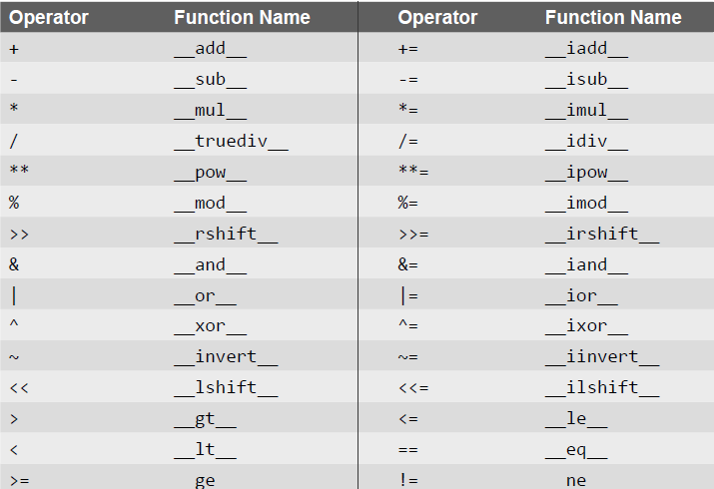
Operators and Their Corresponding Function Names

Slide 5
Write a program to compare two Date objects (Check two dates are equal or not)
class Date:
def __init__(self,d,m,y):
self.d=d
self.m=m
self.y=y
def display(self):
print(self.d,"/",self.m,"/",self.y)
def __eq__(self,da):
if(self.d == da.d and self.m==da.m and self.y==da.y):
return(True)
else:
return(False)
d1 = Date(10,6,1978)
d1.display()
d2 = Date(10,6,1878)
d2.display()
if(d1==d2):
print("Equal")
else:
print("Not Equal")

