Slide 4
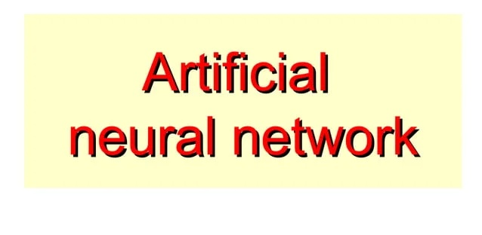

Slide 19
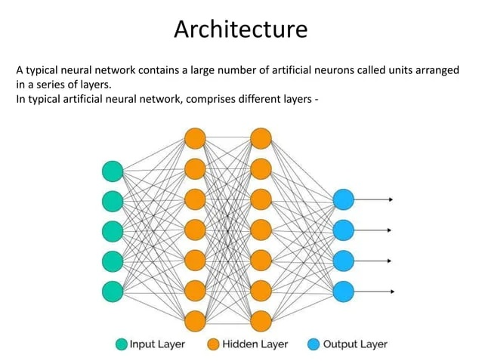

Slide 40
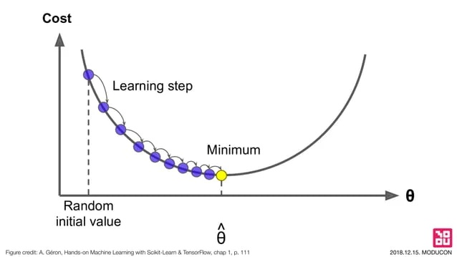

Slide 41
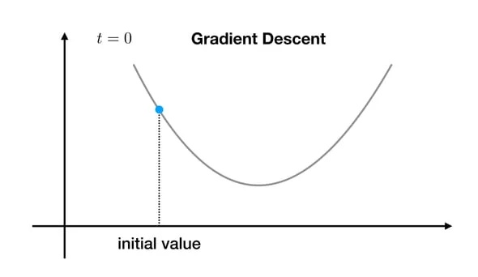

Slide 42
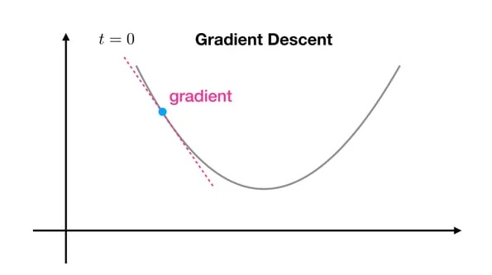

Slide 43
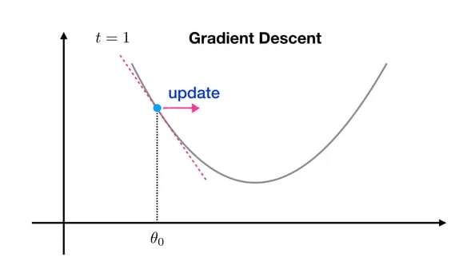

Slide 44
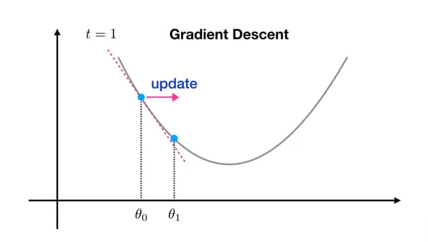

Slide 45
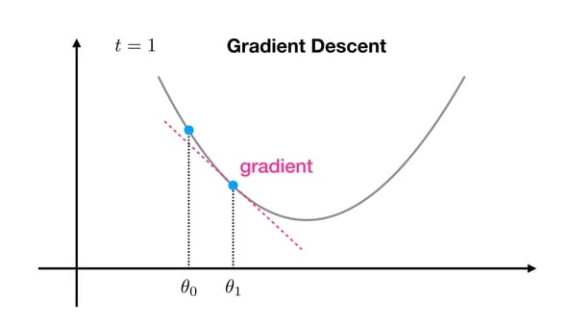

Slide 46
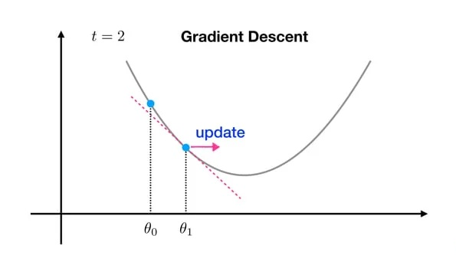

Slide 47
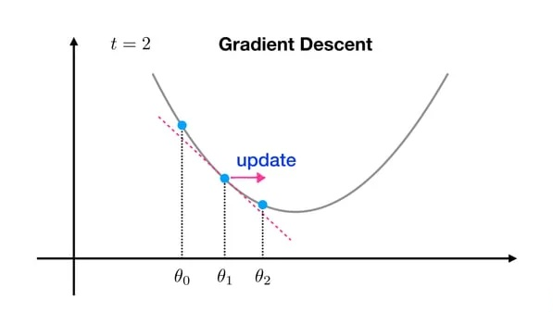

Slide 48
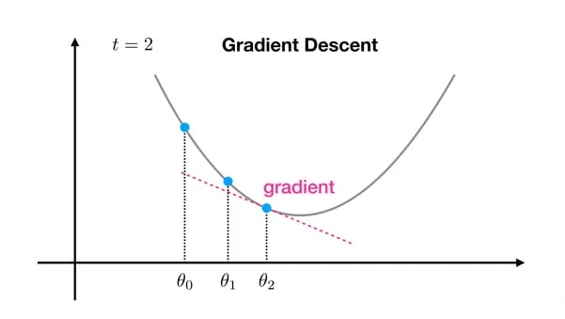

Slide 49
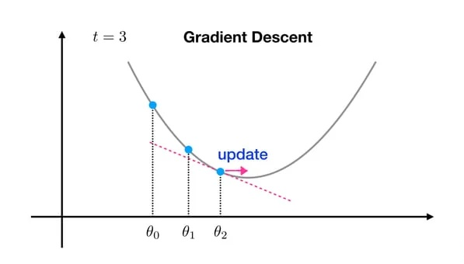

Slide 51
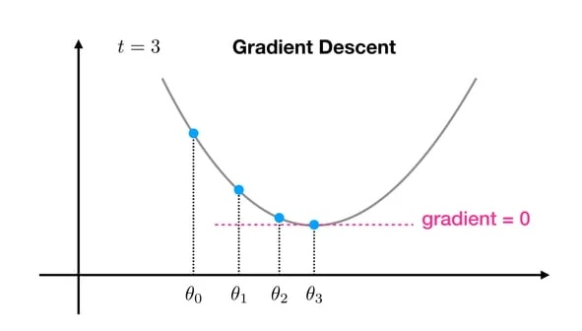

Slide 52
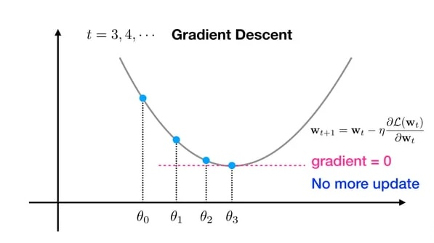

Slide 53
Overview
Oil & gas industry continuously strives to improve its exploration and efficiency in production
A significant proportion of the world oil and gas reserves is contained in weakly consolidated sandstone reservoirs and hence is prone to sand production
Material degradation is a key process leading to sanding.
Drilling operations, cyclic effects of shut-in and build-up, operational conditions, reservoir pressure depletion, and strength-weakening effect of water may gradually lead to sandstone degradation around the perforations and boreholes.
High pressure gradient due to fluid flow also facilitates the detachment of sand particles.
In addition, fluid flow is responsible for the transport and production of cohesion-less sand particles or detached sand clumps to the wellbore
The firm employs an analytical approach, which includes:
Data Exploration
Data Visualization

Slide 54
Objectives & Challenges
Objective(s)
To understand the condition in which sand production may be occurs is vital for production engineers to predict if the well will require a method of sand control.
Challenge(s)
Due to the current global oil price, the sand production is considered undesirable product and the control of sand production is considered as one of the main concerns of production engineers.
It can damage downhole, subsea equipment and surface production facilities, also increasing the risk of catastrophic failure.
It costs the producers multiple millions of dollars each year

Slide 55
Sand Production Process
Erosion of surface
&
sub-surface equipment
Formation
subsistence
Sand accumulation
in
surface equipment
Sand disposal
Subsurface
accumulation

Slide 56
Causes of Sand Production
Production of sand particles consists of formation fines and load bearing solids.
Production rates are often kept to low levels to avoid the production of the load bearing particles, and in many cases, however, low production rates are uneconomical.
The factors that affect sand production in a well include:
Degree of consolidation
Production rate
Pore pressure reduction
Reservoir fluid velocity
Increasing water production

Slide 57
Car Price Prediction using ANN

Slide 58
Overview
How do you evaluate the apt Price for a second hand car?
You look at the number of years, the type of fuel, how many KMS it has run etc.
In this case study, your task is to create a machine learning model which can predict the Price of a car based on its specs.
The problem at hand is to model the selling price of used cars based on the features given in the datasets. It will be used by the client to predict the price of a car of their choice. The mission, is to accept the data, analyze it to make sure that you maximize the probability of them getting the car

Slide 59
About Dataset
The business meaning of each column in the data is as below
Price: The Price of the car in dollars
Age: The age of the car in months
KM: How many KMS did the car was used
HP: Horsepower of the car
MetColor: Whether the car has a metallic color or not
Automatic: Whether car has automatic transmission or not
CC: The engine size of the car
Doors: The number of doors in the car
Weight: The weight of the car

Slide 60
About the ANN Model

Slide 61
Hyper Parameter Tuning
There is no thumb rule which can help you to decide the number of layers/number of neurons etc. in the first look at data. You need to try different parameters and choose the combination which produces the highest accuracy.
Just keep in mind, that, the bigger the network, the more computationally intensive it is, hence it will take more time to run. So always to find the best accuracy with the minimum number of layers/neurons.

Slide 62
Why the accuracy comes different every time ANN is trained?
With the same hyperparameters, the result will be slightly different for each run of ANN.
This happens because the initial step for ANN is the random initialization of weights. So every time you run the code, there are different values that get assigned to each neuron as weights and bias, hence the final outcome also differs slightly.

Slide 63
Key Points to Remember
Deep ANNs work great when you have a good amount of data available for learning.
For small datasets with less than 50K records it is recommended using the supervised ML models like Random Forests, Adaboosts, XGBoosts, etc.
The simple reason behind this is the high complexity and large computations of ANN. It is not worth it, if you can achieve the same accuracy with a faster and simpler model.

