Slide 1
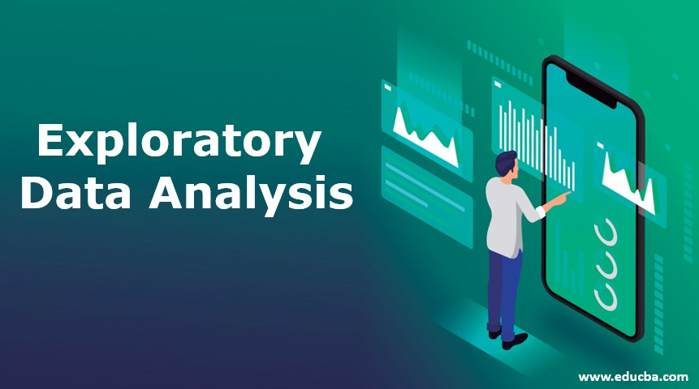
Exploratory Data Analysis
Welcome
to
Technical Session
on

Slide 2
Data Exploration
Data exploration allows a researcher to examine the general trends in the data, to take a close look at data subsets, and to focus on possible relationships between data sets.
Data exploration takes advantage of interactive and dynamically linked visual tools.
Graphs, and tables are displayed in multiple windows and dynamically linked so that selecting records from a dataset will automatically highlight the corresponding features.

Slide 4
Exploratory Data Analysis(EDA)
for
Product Marketing for Retail Banks

Slide 5
Introduction
Data Analytics can become the main driver of innovation in the banking industry.
Data Analytics is gaining prominence in banking sector with investments in Big Data analytics in banking totaled to ($20.8 billion-2016 status).
Typical challenges of Retail Banking segment includes
Valuable customer support
Risk assessment
Decision-making support
Finding new profit opportunities
Investing in new markets

Slide 6
Why Data Analytics for Retail Banking?
Analytics is helping the banking industry become smarter in managing the myriad challenges.
To manage the increasing cost of compliance while minimizing risk(both monetary and reputational) of non-compliance banks are looking towards are analytics-backed solutions.
Sophisticated analytical models for retail banking presents the opportunity to assess short and long term profitability enabling bank’s survival in the future.
Analytics plays a vital role for resolving the challenges of the banking industry while discovering new opportunities.

Slide 7
Does Analytics adds Value to Retail Banking?
The results of data analytics in retail banking can be applied for real time decision making for:
Discovering the spending patterns of the customer.
Identifying the main channels of transactions (ATM withdrawal, credit/debit card payments)
Splitting the customers into segments according to their profiles
Product cross-selling based on the customers’ segmentation
Fraud management & prevention
Risk assessment, compliance & reporting
Customer feedback analysis and application

Slide 8
Challenges and Objectives for Marketing
Challenges
What is a suitable product to recommend to a customer?
What is the best time to market the product?
Which is the most effective channel to contact a customer?
Objectives
To show how a simple predictive analytics exercise may be carried out on real data using open source statistical modelling software.
To demonstrate how the results from a predictive analytics study can be applied to produce real, tangible improvements in a company’s business performance.

Slide 9
Problem Statement
The data is related with direct marketing campaigns of a banking institution. The marketing campaigns were based on phone calls. Often, more than one contact to the same client was required, in order to access if the product (bank term deposit) would be ('yes') or not ('no') subscribed.
The goal is to predict if the client will subscribe a term deposit

Slide 10
Data Format- Categorical Variables
Marital - (Married , Single , Divorced)",
Job - (Management,BlueCollar,Technician,entrepreneur,retired,admin.,services,selfemployed,
housemaid,student,unemployed,unknown)
Contact - (Telephone, Cellular, Unknown)
Education - (Primary, Secondary, Tertiary, Unknown)
Month - (Jan,Feb,Mar,Apr,May,Jun,Jul,Aug,Sep,Oct,Nov,Dec)
Poutcome - (Success, Failure, Other,Unknown)
Housing - (Yes/No)
Loan - (Yes/No)
Default - (Yes/No)

Slide 11
Numerical Variables
Age
Balance
Day
Duration
Campaign
Pdays
Previous
Class Variable
Deposit - (Yes/No)

Slide 12
Aim
To predict, given relevant customer information , whether a particular customer will choose to subscribe to a term deposit product.
A Term deposit is a deposit that a bank or a financial institution offers with a fixed rate (often better than just opening deposit account) in which your money will be returned back at a specific maturity time.
Challenge?
How would such a prediction be of use to the bank?
Usually banks depend on direct marketing campaigns using in-house or out-sourced call centers.
Cost of such sales teams can put a considerable strain on the expense ratio of the product.

Slide 13
Possible Solution
A targeted approach in which the company is able to identify customers who are more likely to subscribe is desirable and would allow greater focus on those customers most likely to generate a sale.
The potential reduction in marketing costs is likely to increase the profit margin of the product overall.

Slide 14
A Scenario
Suppose the bank needs to contact 2,00,000 customers. Each call made to a customer costs $5 and the bank has a total of $1m to spend on marketing.
Assume that the bank generates a profit of $100 for each successful product sale. Historical experience of the bank says that 1 in every 10 calls results in a successful sale.
Suppose the bank were to call 100,000 of our customers randomly, we would expect to have 10,000 sales, and $0.5m in profit after allowing for telemarketing costs ($1m minus $0.5m).

Slide 15
Can this be achieved?
With ‘Data Analytics’ the answer is yes
But How?
On average customers are 10% likely to respond favorably to a marketing call, but in reality this probability varies from one customer to the next.
If the bank finds a way to rank customers from “most likely to buy” (say 50%) to “least likely to buy” (<5%), it could easily increase savings or profits by focusing on the right customers.
This is how, Analytics gives a tremendous added value to retail banking.

Slide 16
Interpretation
The predictive model could help the bank to effectively differentiate customers by ensuring 80% of successful sales from making same number of calls(100,000).
i.e. profit is significantly increased.
Thus an accurate predictive model when applied correctly, can give the bank the potential to significantly improve the financial performance

