Slide 1
Machine Learning and Deep Learning
Jawaharlal Nehru Technological University Hyderabad
Kukatpally, Hyderabad - 500 085, Telangana, India
Data Science Lifecycle and Preprocess Steps
Session 2, 16 Nov 2022
Dr N V Ganapathi Raju
Professor, HOD IT,
G.R.I.E.T. , Hyderabad

Slide 2
AI / ML / DL

Slide 3
Turing Test approach
A computer passes the test of intelligence, if it can fool a human interrogator.
The computer passes the test if a human interrogator, after posing some written questions, cannot tell whether the written responses come from a person or not.
The computer would need to possess the following capabilities:
natural language processing to enable it to communicate successfully in English,
knowledge representation to store what it knows or hears;
automated reasoning to use the stored information to answer questions and to draw new conclusions;
machine learning to adapt to new circumstances and to detect and extrapolate patterns
computer vision to perceive objects, and
robotics to manipulate objects and move about.
Result of Turing Test
If the interrogator can not reliably distinguish the human from the computer
Then the computer does posses artificial intelligence

Slide 4
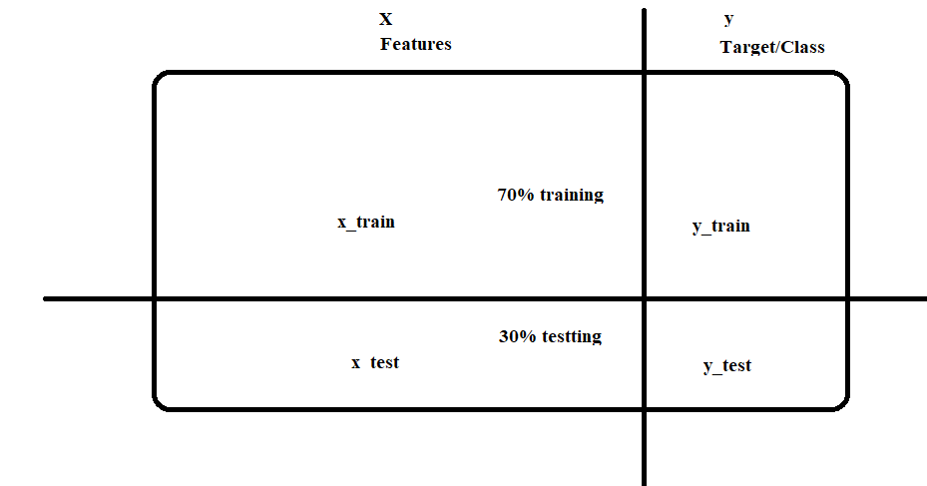
Vocabulary
Target: Predicted category or value of the data (discrete / continuous)
Column to be predicted
Response, Output, Dependent Variable, Labels
Features: Properties of the data used for prediction
Non-Target columns
Predictors, Input, Independent var, attributes
Example: a single data point within the data (one row)
Observations, Record, Instance, row, data points
Label: The target value for a single data point
answer, Category, Y axis

Slide 6
Machine learning is a branch of artificial intelligence (AI) and computer science which focuses on the use of data and algorithms to imitate the way that humans learn, gradually improving its accuracy.
https://www.ibm.com/in-en/cloud/learn/machine-learning
Machine learning (ML) is the process of using mathematical models of data to help a computer learn without direct instruction.
It’s considered a subset of artificial intelligence (AI).
Machine learning uses algorithms to identify patterns within data, and those patterns are then used to create a data model that can make predictions.
With increased data and experience, the results of machine learning are more accurate—much like how humans improve with more practice.
https://azure.microsoft.com/en-in/resources/cloud-computing-dictionary/what-is-machine-learning-platform/

Slide 7
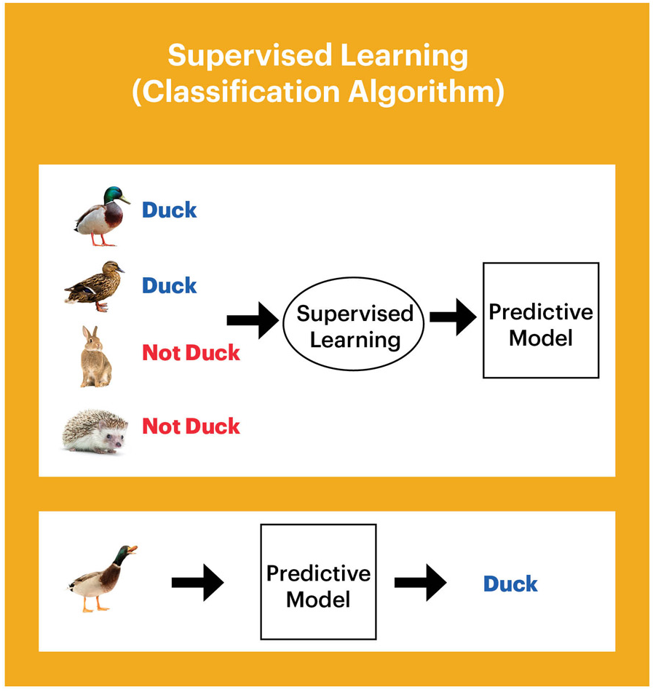
Machine Learning
Allows computers to learn and
infer from data
Types of Machine Learning
Supervised
Unsupervised
Reinforcement Learning
Supervised Learning
Data points have a known outcome
Unsupervised Learning
Data points have unknown outcome

Slide 8
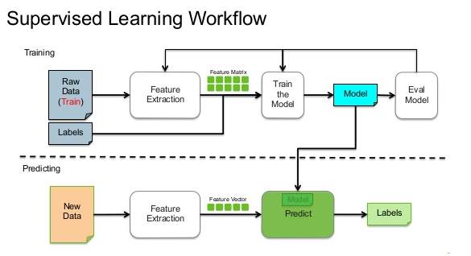
Types of Supervised Learning
Regression Classification
Outcome is continuous (numerical) Outcome is a Category
Ex:- home prices, happiness index Ex:- Object classes in Images

Slide 9
Machine Learning
supervised Learning
unsupervised learning
reinforcement learning
classification
regression
clustering
Q-learning
Markov Decision Process
decision trees
linear
non-linear
K-means
KNN
K-modes
* linear
regression
ANN
Naïve Bayes
K-medoids
SVM
SVM
DBscan
Ridge, Lasso
* logistic regression
agglomerative
divisive
* multinomial logistic regression
Convolutional Neural Network
* Artificial Neural Network
Deep Learning
Recurrent Neural Network

Slide 10
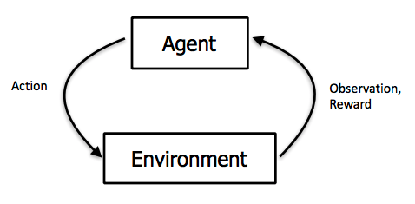
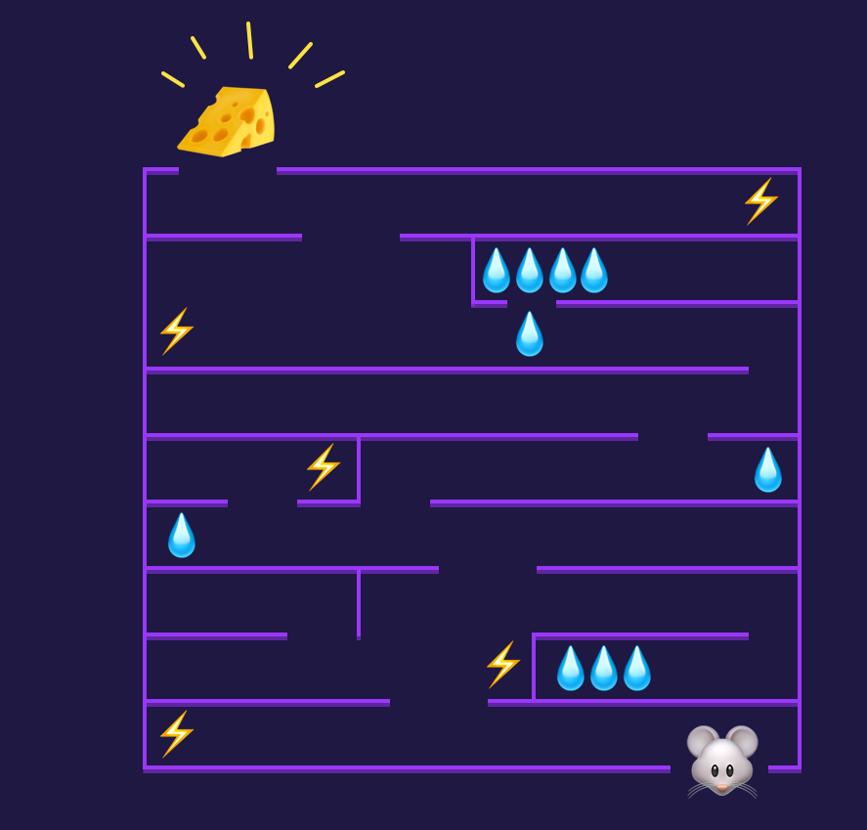
Reinforcement Learning
In supervised learning, training data comes with an answer key from some godlike “supervisor
In reinforcement learning (RL) there’s no answer key, but your reinforcement learning agent still must decide how to act to perform its task.
In the absence of existing training data, the agent learns from experience.
It collects the training examples (“this action was good, that action was bad”) through trial-and-error as it attempts its task, with the goal of maximizing long-term reward.
The agent observes the environment, takes an action to interact with the environment, and receives positive or negative reward.

Slide 11
Steps in Data Science
Problem Identification
Data Collection/Generation
Data Preprocessing
Data Exploration (EDA)
Model Building
Model Evaluation
Analyze Results
Data Wrangling / Munging
Data Imputation
Data Integration
Data Encoding / Decoding
Outlier Analysis
Data Transformation / Normalization
Dimensionality Reduction
Feature Engineering

Slide 12
Data Generation
Range of this attributes are as follows:
Employee_id : 1-100
Age : 25-62
Basic pay : 15,600-67000
No.of clients :1-1000
Years of Services :0-40
Performance Score:0/1

Slide 13
Data Imputation
Many real-world datasets may contain missing values for various reasons. They are often encoded as NaNs, blanks or any other placeholders.
Rule 1: Discrete/Continuous values will be imputed with mean/median/standard deviation
Rule 2: Categorical values will be imputed with mode.
e1['Age'].fillna(e['Age'].mean(),inplace=True)
e1['Basic Pay'].fillna(e['Basic Pay'].mean(),inplace=True)
e1['No of Clients'].fillna(e['No of Clients'].mean(),inplace=True)
e1['Years of Service'].fillna(e['Years of Service'].mean(),inplace=True)
print(e1.head(5))

Slide 14
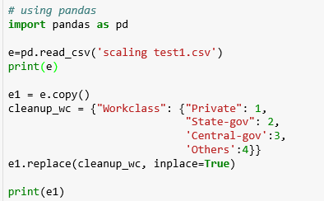
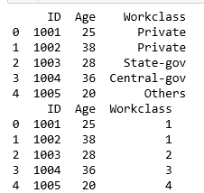
Data Encoding
Most of Machine Learning libraries represent data in numerical values rather than categorical values.
import “LabelEncoder” class from “sklearn.preprocessing” library and create an object labelencoder_X of the LabelEncoder class. After that use the fit_transform method on the categorical features.
One hot encoding transforms categorical features to a format that works better with classification and regression algorithms.

Slide 15
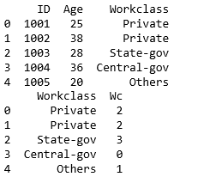
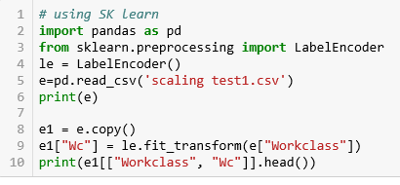
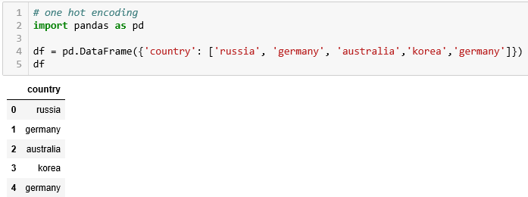
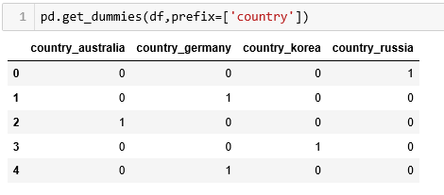
Data Encoding

Slide 16
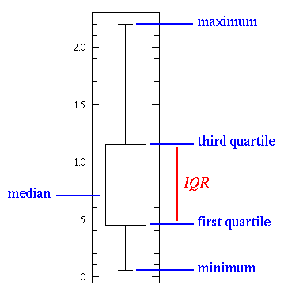
Outlier Detection
Outliers are not just greatest and least values, but values that are very different from the pattern established by the rest of the data. Outliers affect the mean.

Slide 17
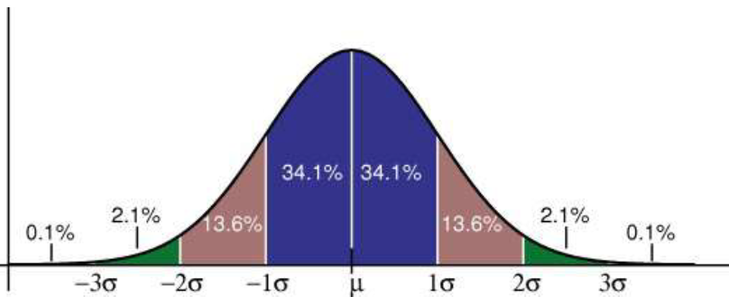
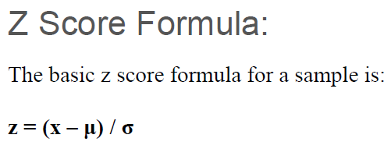
Data Normalization
A normal distribution, sometimes called the bell curve, is a distribution that occurs naturally in many situations.
The empirical rule tells you what percentage of your data falls within a certain number of standard deviations from the mean:
68% of the data falls within one standard deviation of the mean.
95% of the data falls within two standard deviations of the mean.
99.7% of the data falls within three standard deviations of the mean.

Slide 18
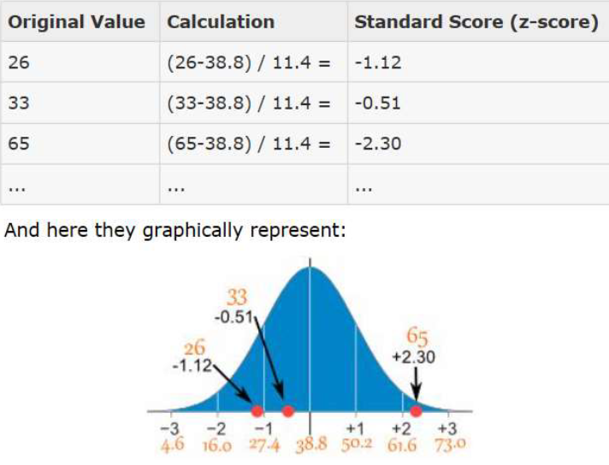

Slide 19
Dimensionality Reduction
As the number of features increases, the model becomes more complex.
The more the number of features, the more the chances of overfitting.
PCA/LDA/SVD are examples
A machine learning model that is trained on many features, gets increasingly dependent on the data it was trained on and in turn overfitted, resulting in poor performance on real data, beating the purpose.

Slide 20
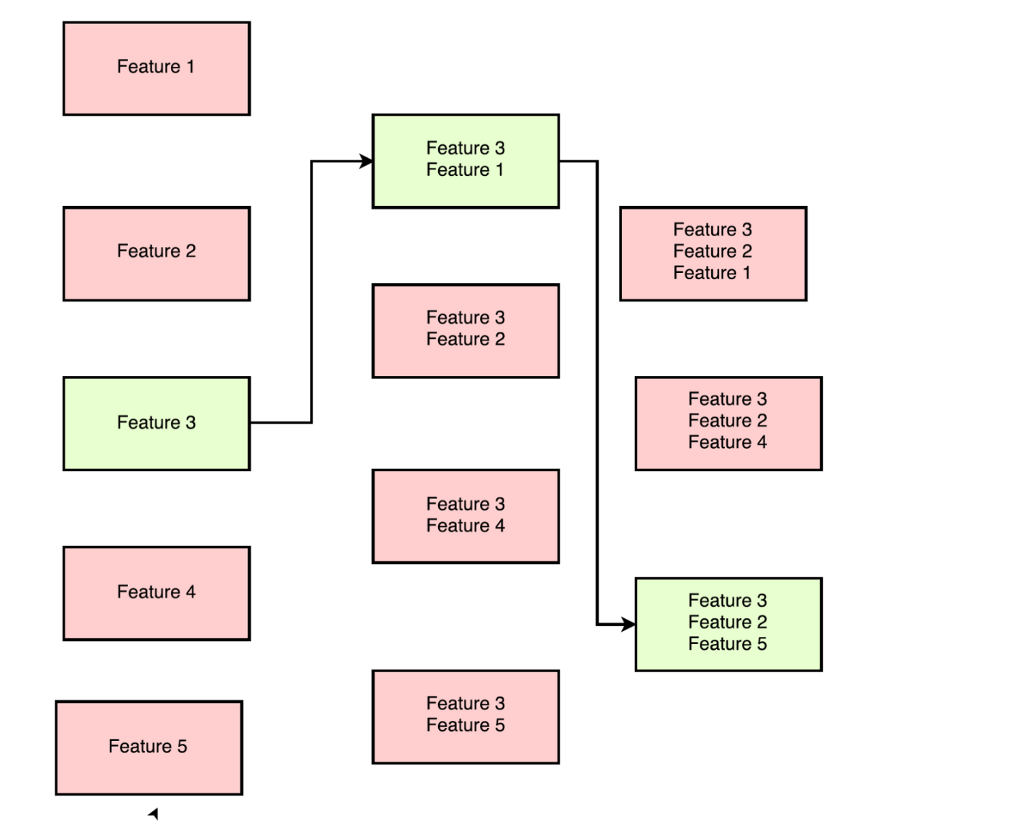
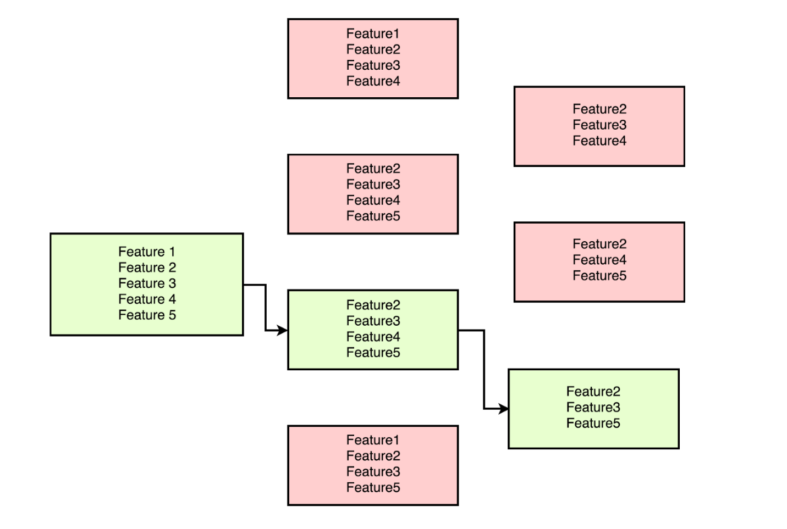
Feature Selection and Engineering
Feature selection is the process of identifying and selecting relevant features for your sample.
Feature engineering is manually generating new features from existing features, by applying some transformation or performing some operation on them.

Slide 21
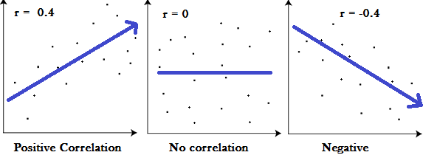
Covariance and correlation
Covariance provides insight into how two variables are related to one another.
Correlation tells that at what degree two or more variables are related.

