Slide 1

Agenda:
Revision
Need for object orientation
OOP Basics and Principles of OOP
Class and object

Slide 2
Revision

Slide 3
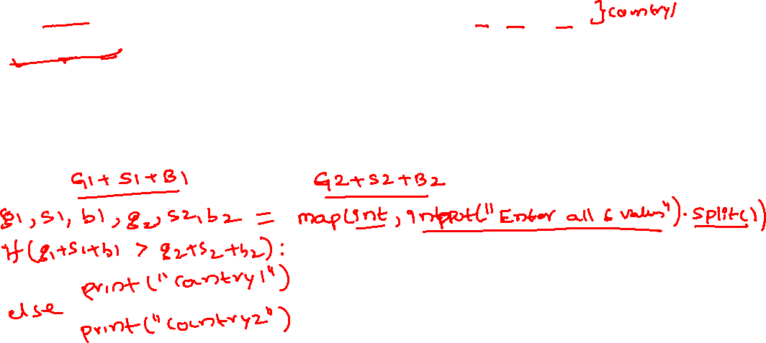
Question1:
In Olympics, the countries are ranked by the total number of medals won. You are given six integers G1, S1, B1, and G2, S2, B2, the number of gold, silver and bronze medals won by two different countries respectively. Determine which country is ranked better on the leader board. It is guaranteed that there will not be a tie between the two countries.

Slide 4
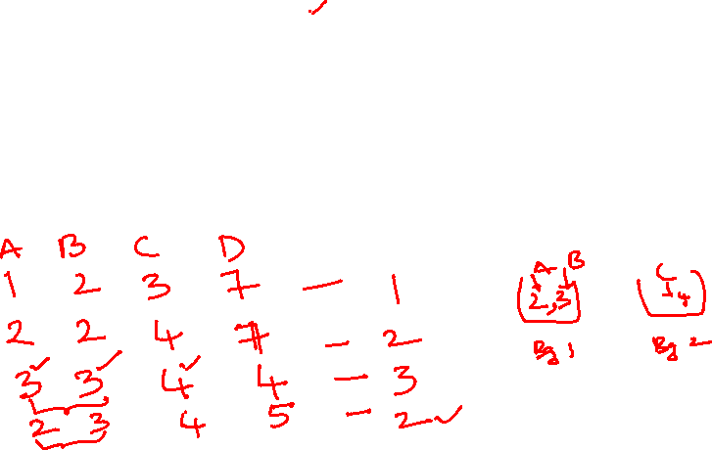
Question2:
Kiran has 3 boxes of sizes A, B, and C respectively. He puts the boxes in bags of size D (A≤B≤C≤D). Develop a code to find the minimum number of bags Kiran needs so that he can put each box in a bag. A bag can contain more than one box if the sum of sizes of boxes in the bag does not exceed the size of the bag.

Slide 5
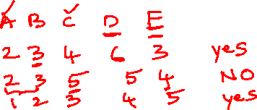
Question 3:
Rani has 3 bags that she wants to take on a flight. They weigh A, B, and C kgs respectively. She wants to check-in exactly two of these bags and carry the remaining one bag with her. The airline restrictions says that the total sum of the weights of the bags that are checked-in cannot exceed D kgs and the weight of the bag which is carried cannot exceed E kgs. Find if Rani can take all the three bags on the flight.

Slide 6
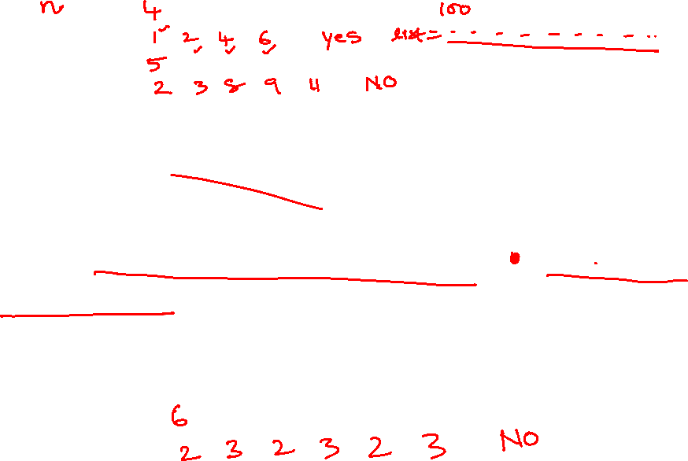
Question 4:
Kattappa is great warier in his time in mahishmathi kingdom. He seems to be more superstitious person. He believes a soldier is lucky if he posses even number of weapons and unlucky otherwise. He will be ready for the battles if no of lucky soldiers are strictly more than number unlucky soldiers. Given number of soldiers and weapons they poses develop python code to find weather Kattappa is Ready for the battle or not

Slide 7
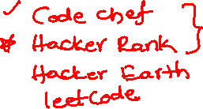
Question 5:
Amish is a software developer, so he has to switch between different languages sometimes. Each programming language has some features, which are represented by integers here.
Currently, Amish has to use a language with two given features A and B. He has two options --- switching to a language with two features A1 and B1, or to a language with two features A2 and B2. All four features of these two languages are pairwise distinct.
Tell Amish whether he can use the first language, the second language or neither of these languages (if no single language has all the required features)

Slide 8
Assignment 1:
Pooja would like to withdraw X $US from an ATM. The cash machine will only accept the transaction if X is a multiple of 5, and Pooja's account balance has enough cash to perform the withdrawal transaction (including bank charges). For each successful withdrawal the bank charges 0.50 $US. Calculate Pooja's account balance after an attempted transaction.
Example - Successful Transaction
Input: 30 120.00
Output: 89.50
Example - Incorrect Withdrawal Amount (not multiple of 5)
Input: 42 120.00
Output: 120.00
Example - Insufficient Funds
Input: 300 120.00
Output: 120.00

Slide 9
Assignment 2:
You have prepared four problems. The difficulty levels of the problems are A1,A2,A3,A4 respectively. A problem set comprises at least two problems and no two problems in a problem set should have the same difficulty level. A problem can belong to at most one problem set. Find the maximum number of problem sets you can create using the four problems.
Each test case contains four space-separated integers A1, A2, A3, A4, denoting the difficulty level of four problems.
For each test case, print a single line containing one integer - the maximum number of problem sets you can create using the four problems.

Slide 10
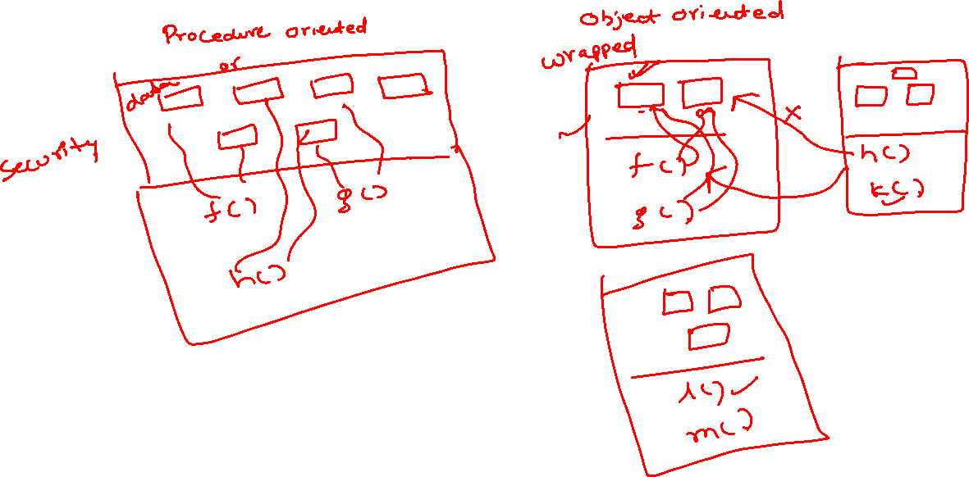


Need for Object Orientation

Slide 11

Principles of OOP
Class & Object
Abstraction
Encapsulation
Inheritance
Polymorphism

Slide 12

Class & Object
Classes provides a blueprint or a template using which objects are created
A class creates a new type and object is an instance (or variable) of the class
in Python, everything is an object or an instance of some class
For example, all integer variables that we define in our program are actually instances of class int.

Slide 13
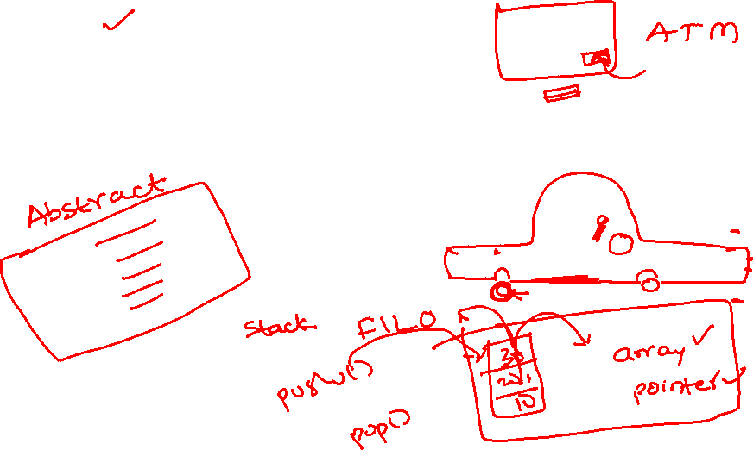
Abstraction
Hiding the unnecessary information
Hiding implementation details

Slide 14
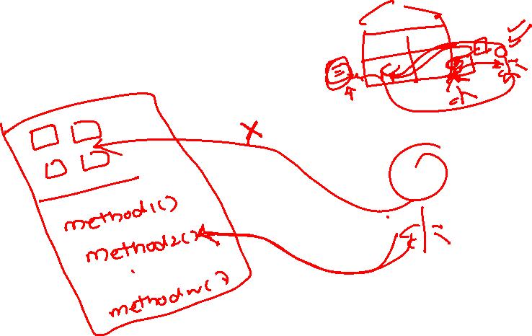
Encapsulation
Wrapping of data and methods

Slide 15
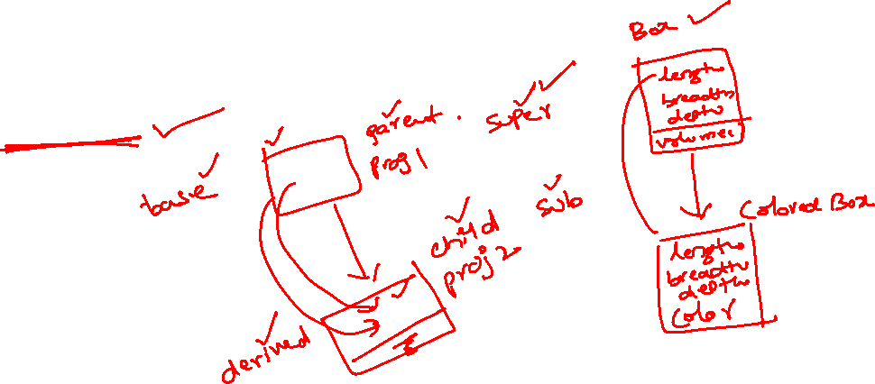
Inheritance
Acquiring properties of parent to child
Reusability

Slide 16
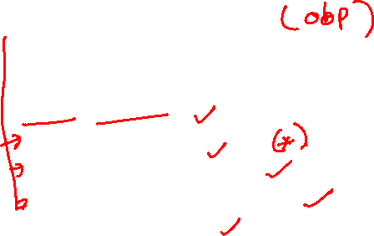
Polymorphism
Many forms
Method overloading
Method overriding
Operator overloading

Slide 17


Defining a class
Creating an object

Slide 18
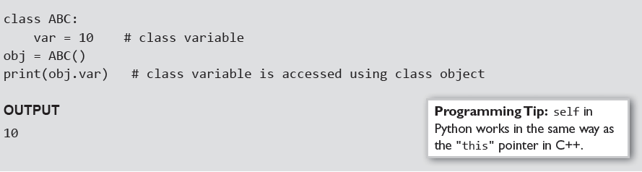
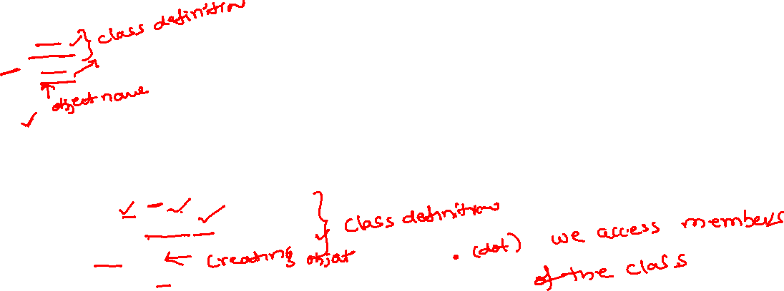
Example1:
Example 2:

Slide 19
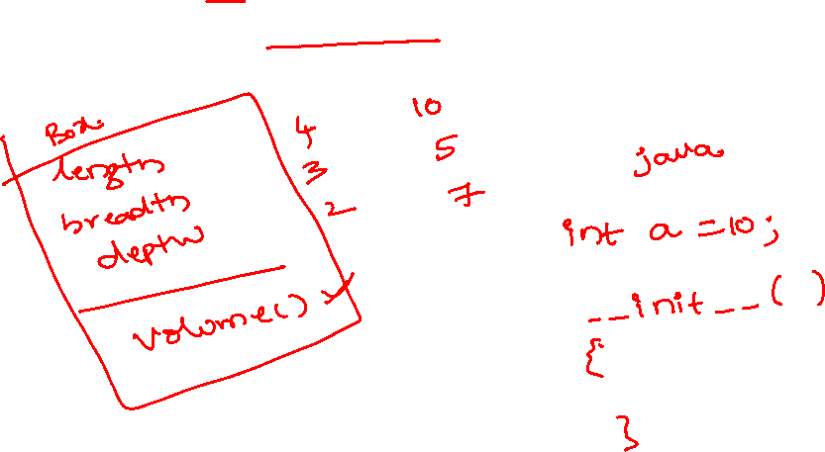
Example 3:
Create a class called Box which has three dimensions length, breadth, depth. Create a constructor and define volume method. Use volume method to find volume of the Box object

Slide 20
Example 4:
Create a class called Rect which has two dimensions length, breadth. Create a constructor and define methods called area() and perimeter(). Use these methods to find area and perimeter of the Rect object

