Slide 1
Numpy
Mathematical computing using python
Numerical Computing in Python

Slide 2
What is Numpy?
Numpy, Scipy, and Matplotlib provide MATLAB-like functionality in python.
Numpy Features:
Typed multidimentional arrays (matrices)
Fast numerical computations (matrix math)
High-level math functions

Slide 3
Why do we need NumPy
Let’s see for ourselves!

Slide 4
Why do we need NumPy
Python does numerical computations slowly.
1000 x 1000 matrix multiply
Python triple loop takes > 10 min.
Numpy takes ~0.03 seconds

Slide 5
NumPy Overview
Arrays
Shaping and transposition
Mathematical Operations
Indexing and slicing
Broadcasting

Slide 6
Arrays
Structured lists of numbers.
Vectors
Matrices
$$\left[\begin{matrix}p_{x} \\ p_{y} \\ p_{z}\end{matrix}\right]$$
$$\left[\begin{matrix}a_{11} & ⋯ & a_{1n} \\ ⋮ & ⋱ & ⋮ \\ a_{m1} & ⋯ & a_{mn}\end{matrix}\right]$$

Slide 7
Arrays, Basic Properties
import numpy as np
a = np.array([[1,2,3],[4,5,6]],dtype=np.float32)
print a.ndim, a.shape, a.dtype
Arrays can have any number of dimensions, including zero (a scalar).
Arrays are typed: np.uint8, np.int64, np.float32, np.float64
Arrays are dense. Each element of the array exists and has the same type.

Slide 8
Arrays, creation
np.ones, np.zeros
np.arange
np.concatenate
np.astype
np.zeros_like, np.ones_like
np.random.random

Slide 9
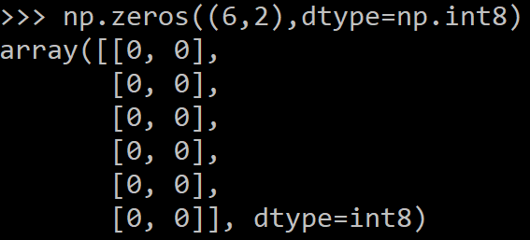
Arrays, creation
np.ones, np.zeros
np.arange
np.concatenate
np.astype
np.zeros_like, np.ones_like
np.random.random

Slide 10
Arrays, creation
np.ones, np.zeros
np.arange
np.concatenate
np.astype
np.zeros_like, np.ones_like
np.random.random

Slide 11
Arrays, creation
np.ones, np.zeros
np.arange
np.concatenate
np.astype
np.zeros_like, np.ones_like
np.random.random

Slide 12
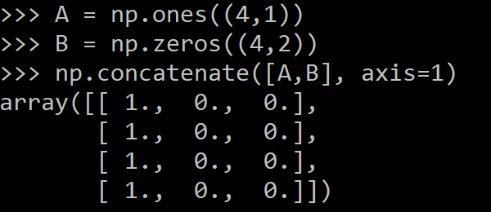
Arrays, creation
np.ones, np.zeros
np.arange
np.concatenate
np.astype
np.zeros_like, np.ones_like
np.random.random

Slide 13
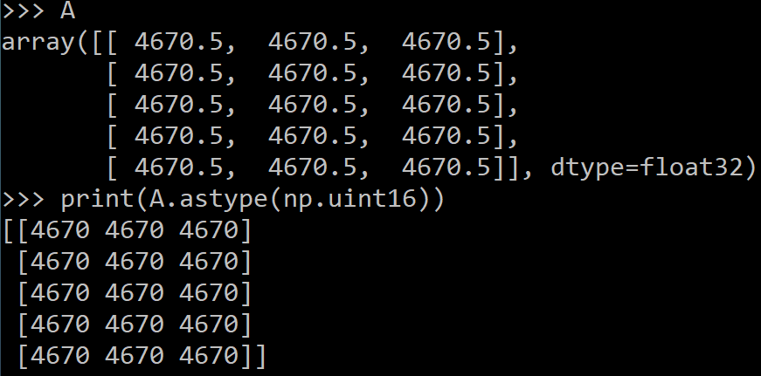
Arrays, creation
np.ones, np.zeros
np.arange
np.concatenate
np.astype
np.zeros_like, np.ones_like
np.random.random

Slide 14
Arrays, creation
np.ones, np.zeros
np.arange
np.concatenate
np.astype
np.zeros_like, np.ones_like
np.random.random

Slide 15
Arrays, creation
np.ones, np.zeros
np.arange
np.concatenate
np.astype
np.zeros_like, np.ones_like
np.random.random

Slide 16
Arrays, danger zone
Must be dense, no holes.
Must be one type
Cannot combine arrays of different shape

Slide 17
Shaping
a = np.array([1,2,3,4,5,6])
a = a.reshape(3,2)
a = a.reshape(2,-1)
a = a.ravel()

Slide 18
Transposition
a = np.arange(10).reshape(5,2)
a = a.T
a = a.transpose()
.

Slide 19
Mathematical operators
Arithmetic operations are element-wise
Logical operator return a bool array
In place operations modify the array

Slide 20
Mathematical operators
Arithmetic operations are element-wise
Logical operator return a bool array
In place operations modify the array

Slide 21
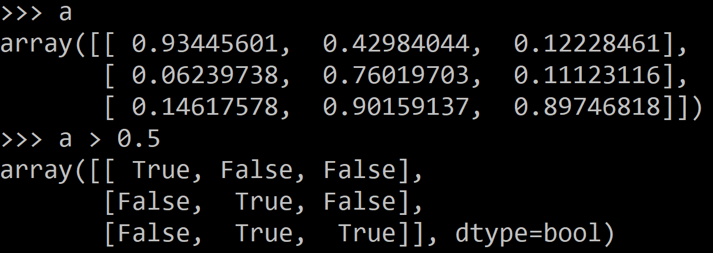
Mathematical operators
Arithmetic operations are element-wise
Logical operator return a bool array
In place operations modify the array

Slide 22
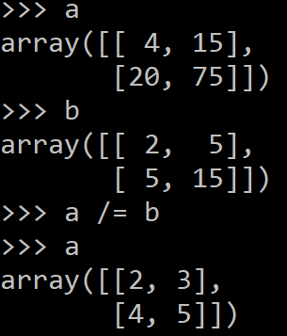
Mathematical operators
Arithmetic operations are element-wise
Logical operator return a bool array
In place operations modify the array

Slide 23
Math, upcasting
Just as in Python and Java, the result of a math operator is cast to the more general or precise datatype.
uint64 + uint16 => uint64
float32 / int32 => float32
Warning: upcasting does not prevent overflow/underflow. You must manually cast first.
Use case: images often stored as uint8. You should convert to float32 or float64 before doing math.

Slide 24
Math, universal functions
Also called ufuncs
Element-wise
Examples:
np.exp
np.sqrt
np.sin
np.cos
np.isnan

Slide 25
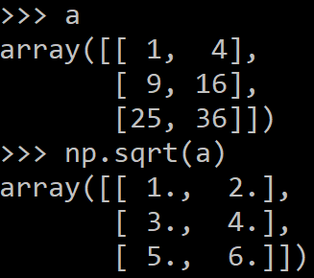
Math, universal functions
Also called ufuncs
Element-wise
Examples:
np.exp
np.sqrt
np.sin
np.cos
np.isnan

Slide 26
Indexing
x[0,0] # top-left element
x[0,-1] # first row, last column
x[0,:] # first row (many entries)
x[:,0] # first column (many entries)
Notes:
Zero-indexing
Multi-dimensional indices are comma-separated (i.e., a tuple)

Slide 27
Python Slicing
Syntax: start:stop:step
a = list(range(10))
a[:3] # indices 0, 1, 2
a[-3:] # indices 7, 8, 9
a[3:8:2] # indices 3, 5, 7
a[4:1:-1] # indices 4, 3, 2 (this one is tricky)

Slide 28
Axes
a.sum() # sum all entries
a.sum(axis=0) # sum over rows
a.sum(axis=1) # sum over columns
a.sum(axis=1, keepdims=True)
Use the axis parameter to control which axis NumPy operates on
Typically, the axis specified will disappear, keepdims keeps all dimensions

Slide 29
Broadcasting
a = a + 1 # add one to every element
When operating on multiple arrays, broadcasting rules are used.
Each dimension must match, from right-to-left
Dimensions of size 1 will broadcast (as if the value was repeated).
Otherwise, the dimension must have the same shape.
Extra dimensions of size 1 are added to the left as needed.

Slide 30
Broadcasting example
Suppose we want to add a color value to an image
a.shape is 100, 200, 3
b.shape is 3
a + b will pad b with two extra dimensions so it has an effective shape of 1 x 1 x 3.
So, the addition will broadcast over the first and second dimensions.

Slide 31
Broadcasting failures
If a.shape is 100, 200, 3 but b.shape is 4 then a + b will fail. The trailing dimensions must have the same shape (or be 1)

Slide 32
Thank You

