Slide 1

Jawaharlal Nehru Technological University Hyderabad
S C D E
Kukatpally, Hyderabad - 500 085, Telangana, India
Pandas for Data Analysis
Session 17 , 8 June 23
Dr N V Ganapathi Raju
Professor and HOD of IT
Gokaraju Rangaraju Institute of Eng and Tech

Slide 2
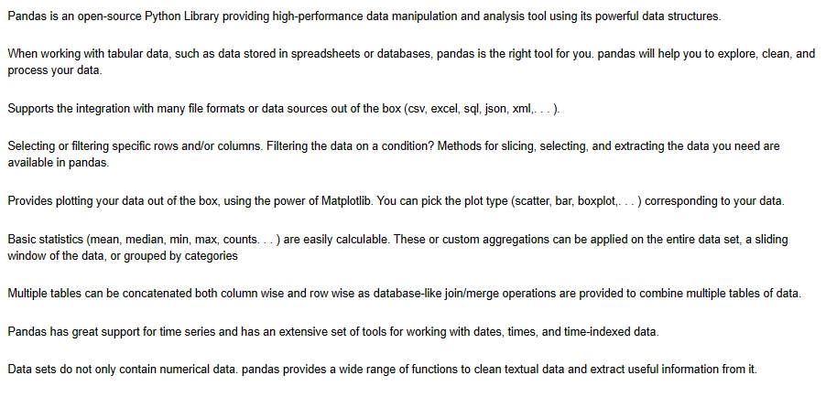
Features of Pandas

Slide 3
Numerous kinds of data
Text data (.doc, .txt, .pdf…)
Excel data (.csv, .tsv)
HTML data
XML data
JSON data
Relational Database (Oracle, MySql, Sqlite…)
Log files / Transactional data
Sensors/Web servers
Social Media data (FB, Twitter, WhatsApp, YouTube…)
Image / Audio / Video / Signal….

