Slide 1
Statistics for Data Science
By
Dr. S. Suresh Kumar
Assistant Professor and Head I.T
J.N.T.U.H UCEJ

Slide 2
Basics of Statistics
Definition: Science of collection, presentation, analysis, and reasonable interpretation of data.
Statistics presents a rigorous scientific method for gaining insight into data.
For example, suppose we measure the weight of 100 patients in a study. With so many measurements, simply looking at the data fails to provide an informative account. However statistics can give an instant overall picture of data based on graphical presentation or numerical summarization irrespective to the number of data points. Besides data summarization, another important task of statistics is to make inference and predict relations of variables.

Slide 3
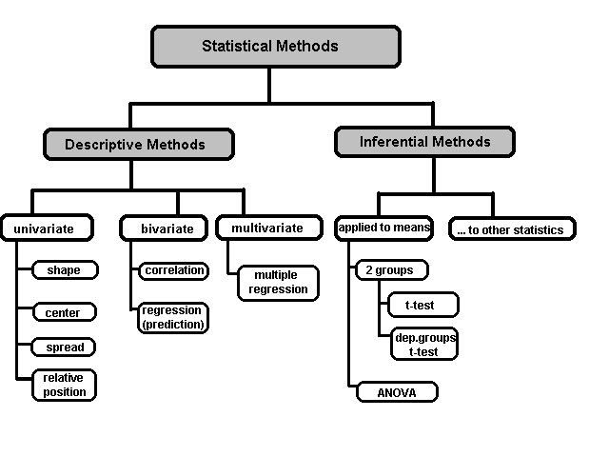
A Taxonomy of Statistics

Slide 4
Statistical Description of Data
Statistics describes a numeric set of data by its
Center
Variability
Shape
Statistics describes a categorical set of data by
Frequency, percentage or proportion of each category

Slide 5
Some Definitions
Variable - any characteristic of an individual or entity. A variable can take different values for different individuals. Variables can be categorical or quantitative. Per S. S. Stevens…
Nominal - Categorical variables with no inherent order or ranking sequence such as names or classes (e.g., gender). Value may be a numerical, but without numerical value (e.g., I, II, III). The only operation that can be applied to Nominal variables is enumeration.
Ordinal - Variables with an inherent rank or order, e.g. mild, moderate, severe. Can be compared for equality, or greater or less, but not how much greater or less.
Interval - Values of the variable are ordered as in Ordinal, and additionally, differences between values are meaningful, however, the scale is not absolutely anchored. Calendar dates and temperatures on the Fahrenheit scale are examples. Addition and subtraction, but not multiplication and division are meaningful operations.
Ratio - Variables with all properties of Interval plus an absolute, non-arbitrary zero point, e.g. age, weight, temperature (Kelvin). Addition, subtraction, multiplication, and division are all meaningful operations.

Slide 6
Some Definitions
Distribution - (of a variable) tells us what values the variable takes and how often it takes these values.
Unimodal - having a single peak
Bimodal - having two distinct peaks
Symmetric - left and right half are mirror images.

Slide 7
Frequency Distribution
Consider a data set of 26 children of ages 1-6 years. Then the frequency distribution of variable ‘age’ can be tabulated as follows:
Frequency Distribution of Age
Age | 1 | 2 | 3 | 4 | 5 | 6
Frequency | 5 | 3 | 7 | 5 | 4 | 2
Grouped Frequency Distribution of Age:
Age Group | 1-2 | 3-4 | 5-6
Frequency | 8 | 12 | 6

Slide 8
Cumulative Frequency
Cumulative frequency of data in previous page
Age | 1 | 2 | 3 | 4 | 5 | 6
Frequency | 5 | 3 | 7 | 5 | 4 | 2
Cumulative Frequency | 5 | 8 | 15 | 20 | 24 | 26
Age Group | 1-2 | 3-4 | 5-6
Frequency | 8 | 12 | 6
Cumulative Frequency | 8 | 20 | 26

Slide 9
Data Presentation
Two types of statistical presentation of data - graphical and numerical.
Graphical Presentation: We look for the overall pattern and for striking deviations from that pattern. Over all pattern usually described by shape, center, and spread of the data. An individual value that falls outside the overall pattern is called an outlier.
Bar diagram and Pie charts are used for categorical variables.
Histogram, stem and leaf and Box-plot are used for numerical variable.

Slide 10
Data Presentation –Categorical Variable
Bar Diagram: Lists the categories and presents the percent or count of individuals who fall in each category.
Treatment Group | Frequency | Proportion | Percent (%)
1 | 15 | (15/60)=0.25 | 25.0
2 | 25 | (25/60)=0.417 | 41.7
3 | 20 | (20/60)=0.333 | 33.3
Total | 60 | 1.00 | 100

Slide 11
Data Presentation –Categorical Variable
Pie Chart: Lists the categories and presents the percent or count of individuals who fall in each category.
Treatment Group | Frequency | Proportion | Percent (%)
1 | 15 | (15/60)=0.25 | 25.0
2 | 25 | (25/60)=0.417 | 41.7
3 | 20 | (20/60)=0.33 | 33.3
Total | 60 | 1.00 | 100

Slide 12
Graphical Presentation –Numerical Variable
Histogram: Overall pattern can be described by its shape, center, and spread. The following age distribution is right skewed. The center lies between 80 to 100. No outliers.
Mean | 90.41666667
Standard Error | 3.902649518
Median | 84
Mode | 84
Standard Deviation | 30.22979318
Sample Variance | 913.8403955
Kurtosis | -1.183899591
Skewness | 0.389872725
Range | 95
Minimum | 48
Maximum | 143
Sum | 5425
Count | 60

Slide 13
Graphical Presentation –Numerical Variable
Box-Plot: Describes the five-number summary
Figure 3: Distribution of Age
Box Plot

Slide 14
Numerical Presentation
A fundamental concept in summary statistics is that of a central value for a set of observations and the extent to which the central value characterizes the whole set of data. Measures of central value such as the mean or median must be coupled with measures of data dispersion (e.g., average distance from the mean) to indicate how well the central value characterizes the data as a whole.
To understand how well a central value characterizes a set of observations, let us consider the following two sets of data:
A: 30, 50, 70
B: 40, 50, 60
The mean of both two data sets is 50. But, the distance of the observations from the mean in data set A is larger than in the data set B. Thus, the mean of data set B is a better representation of the data set than is the case for set A.

Slide 15
Methods of Center Measurement
Center measurement is a summary measure of the overall level of a dataset
Commonly used methods are mean, median, mode, geometric mean etc.
Mean: Summing up all the observation and dividing by number of observations. Mean of 20, 30, 40 is (20+30+40)/3 = 30.

Slide 16
Methods of Center Measurement
Median: The middle value in an ordered sequence of observations. That is, to find the median we need to order the data set and then find the middle value. In case of an even number of observations the average of the two middle most values is the median. For example, to find the median of {9, 3, 6, 7, 5}, we first sort the data giving {3, 5, 6, 7, 9}, then choose the middle value 6. If the number of observations is even, e.g., {9, 3, 6, 7, 5, 2}, then the median is the average of the two middle values from the sorted sequence, in this case, (5 + 6) / 2 = 5.5.
Mode: The value that is observed most frequently. The mode is undefined for sequences in which no observation is repeated.

Slide 17
Mean or Median
The median is less sensitive to outliers (extreme scores) than the mean and thus a better measure than the mean for highly skewed distributions, e.g. family income. For example mean of 20, 30, 40, and 990 is (20+30+40+990)/4 =270. The median of these four observations is (30+40)/2 =35. Here 3 observations out of 4 lie between 20-40. So, the mean 270 really fails to give a realistic picture of the major part of the data. It is influenced by extreme value 990.

Slide 18
Methods of Variability Measurement
Variability (or dispersion) measures the amount of scatter in a dataset.
Commonly used methods: range, variance, standard deviation, interquartile range, coefficient of variation etc.
Range: The difference between the largest and the smallest observations. The range of 10, 5, 2, 100 is (100-2)=98. It’s a crude measure of variability.

Slide 19
Methods of Variability Measurement
Variance: The variance of a set of observations is the average of the squares of the deviations of the observations from their mean. In symbols, the variance of the n observations x₁, x₂,…x_{n} is
Variance of 5, 7, 3? Mean is (5+7+3)/3 = 5 and the variance is
Standard Deviation: Square root of the variance. The standard deviation of the above example is 2.

Slide 20
Methods of Variability Measurement
Quartiles: Data can be divided into four regions that cover the total range of observed values. Cut points for these regions are known as quartiles.
In notations, quartiles of a data is the ((n+1)/4)q^{th} observation of the data, where q is the desired quartile and n is the number of observations of data.
The first quartile (Q1) is the first 25% of the data. The second quartile (Q2) is between the 25th and 50th percentage points in the data. The upper bound of Q2 is the median. The third quartile (Q3) is the 25% of the data lying between the median and the 75% cut point in the data.
Q1 is the median of the first half of the ordered observations and Q3 is the median of the second half of the ordered observations.

Slide 21
Methods of Variability Measurement
In the following example Q1= ((15+1)/4)1 =4th observation of the data. The 4th observation is 11. So Q1 is of this data is 11.
An example with 15 numbers
3 6 7 11 13 22 30 40 44 50 52 61 68 80 94 Q1 Q2 Q3
The first quartile is Q1=11. The second quartile is Q2=40 (This is also the Median.) The third quartile is Q3=61.
Inter-quartile Range: Difference between Q3 and Q1. Inter-quartile range of the previous example is 61- 40=21. The middle half of the ordered data lie between 40 and 61.

Slide 22
Deciles and Percentiles
Deciles: If data is ordered and divided into 10 parts, then cut points are called Deciles
Percentiles: If data is ordered and divided into 100 parts, then cut points are called Percentiles. 25th percentile is the Q1, 50th percentile is the Median (Q2) and the 75th percentile of the data is Q3.
In notations, percentiles of a data is the ((n+1)/100)p th observation of the data, where p is the desired percentile and n is the number of observations of data.
Coefficient of Variation: The standard deviation of data divided by it’s mean. It is usually expressed in percent.
Coefficient of Variation =

Slide 23
Five Number Summary
Five Number Summary: The five number summary of a distribution consists of the smallest (Minimum) observation, the first quartile (Q1),
The median(Q2), the third quartile, and the largest (Maximum) observation written in order from smallest to largest.
Box Plot: A box plot is a graph of the five number summary. The central box spans the quartiles. A line within the box marks the median. Lines extending above and below the box mark the smallest and the largest observations (i.e., the range). Outlying samples may be additionally plotted outside the range.

Slide 24
Boxplot
Distribution of Age in Month

Slide 25
Choosing a Summary
The five number summary is usually better than the mean and standard deviation for describing a skewed distribution or a distribution with extreme outliers. The mean and standard deviation are reasonable for symmetric distributions that are free of outliers.
In real life we can’t always expect symmetry of the data. It’s a common practice to include number of observations (n), mean, median, standard deviation, and range as common for data summarization purpose. We can include other summary statistics like Q1, Q3, Coefficient of variation if it is considered to be important for describing data.

Slide 26
Statistics module in python
Python has a built-in module that you can use to calculate mathematical statistics of numeric data.

Slide 27
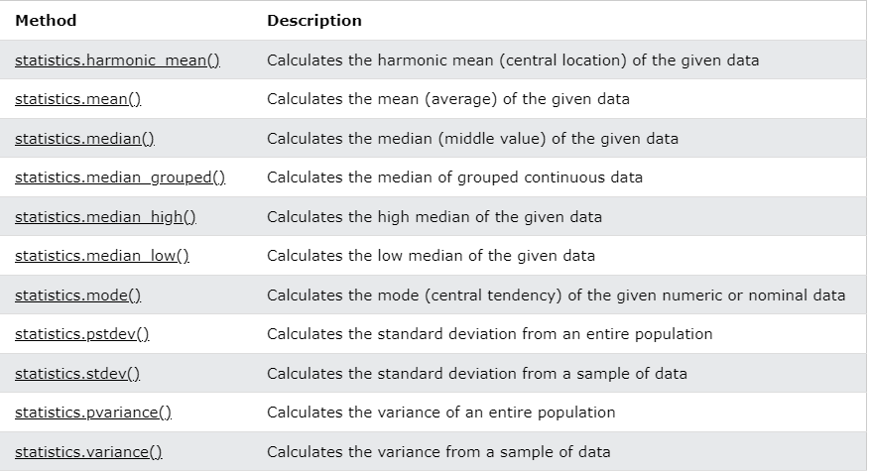

Slide 28
Describe() in python
The describe() method returns description of the data in the DataFrame.
If the DataFrame contains numerical data, the description contains these information for each column:
count - The number of not-empty values. mean - The average (mean) value. std - The standard deviation. min - the minimum value. 25% - The 25% percentile*. 50% - The 50% percentile*. 75% - The 75% percentile*. max - the maximum value.

Slide 29
Thank You

